Slide 1
ADM ASP.NET WEB API SKILL BASED ASSESSMENT
Assessment Guidelines
April 2022

Slide 2
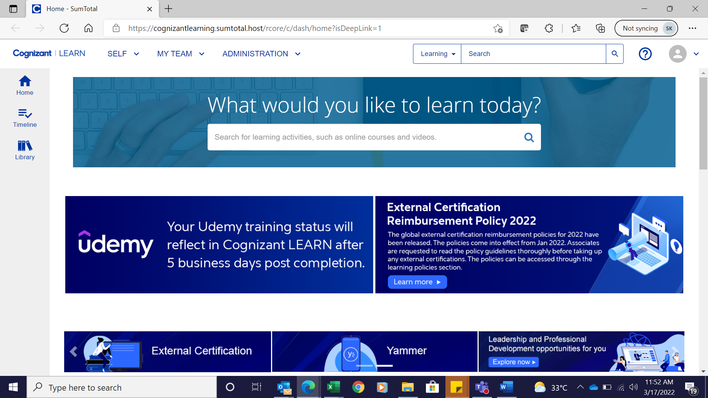
Step 1: Login to Cognizant Learn

Slide 3
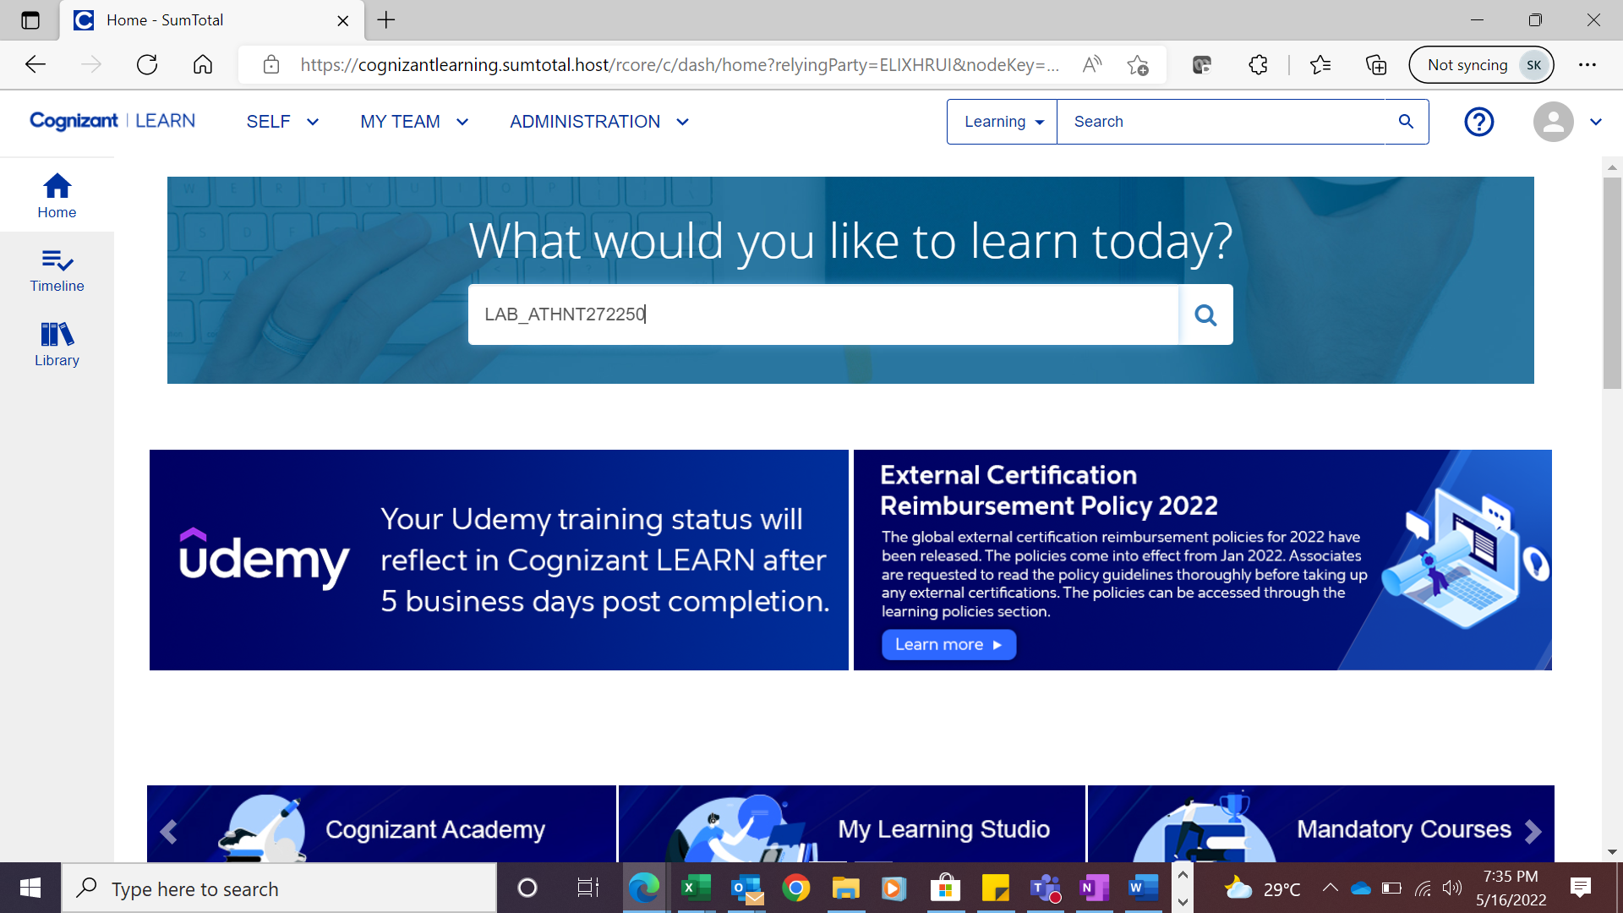
Step 2 : Search with Course code

Slide 4
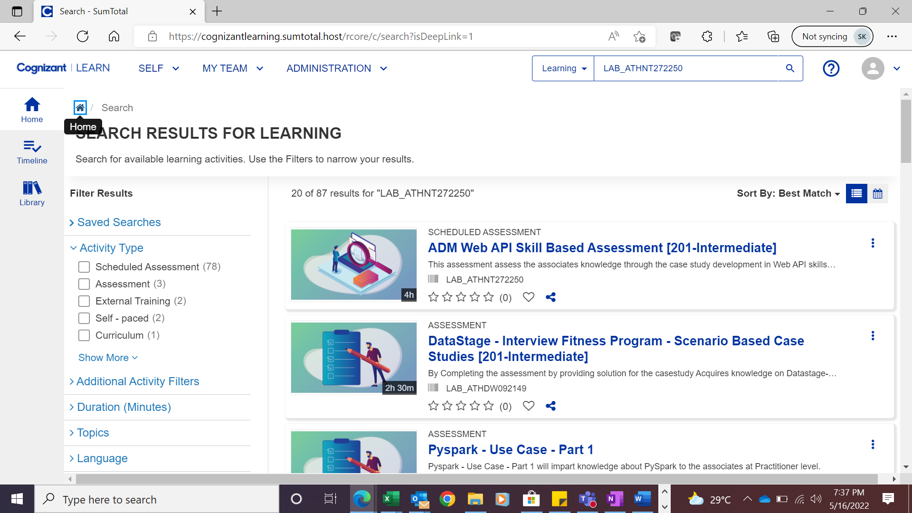
Step 3 : Search result will display the course code details as shown below:
Click on the Course code to open.

Slide 5
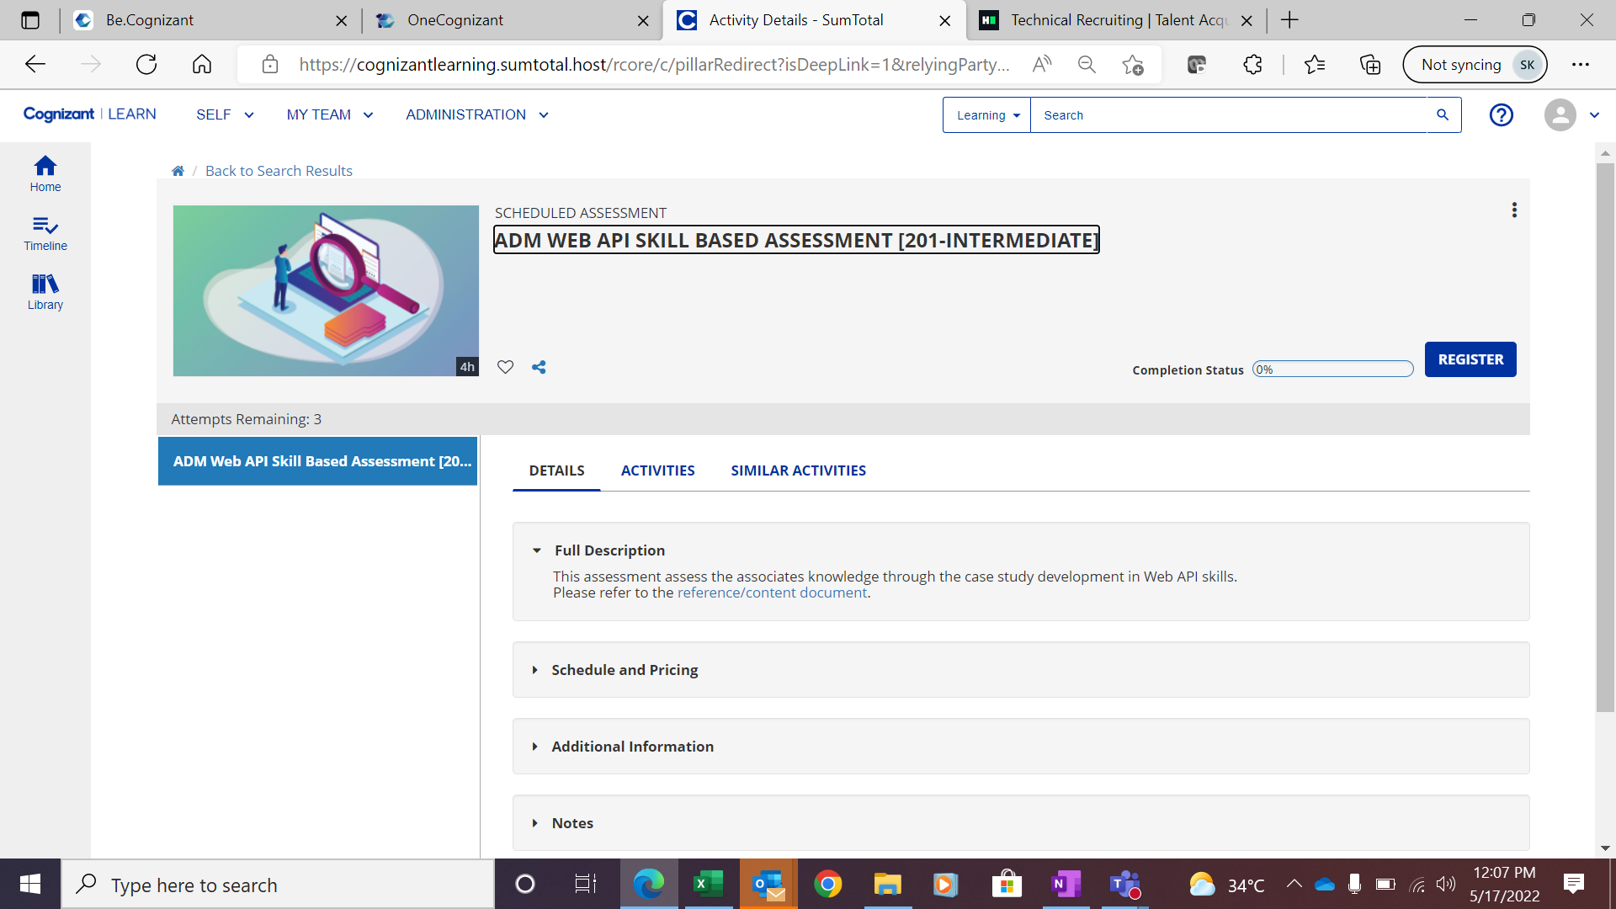
Step 4 : Read the full description of the course before registering , then click the Register button.

Slide 6
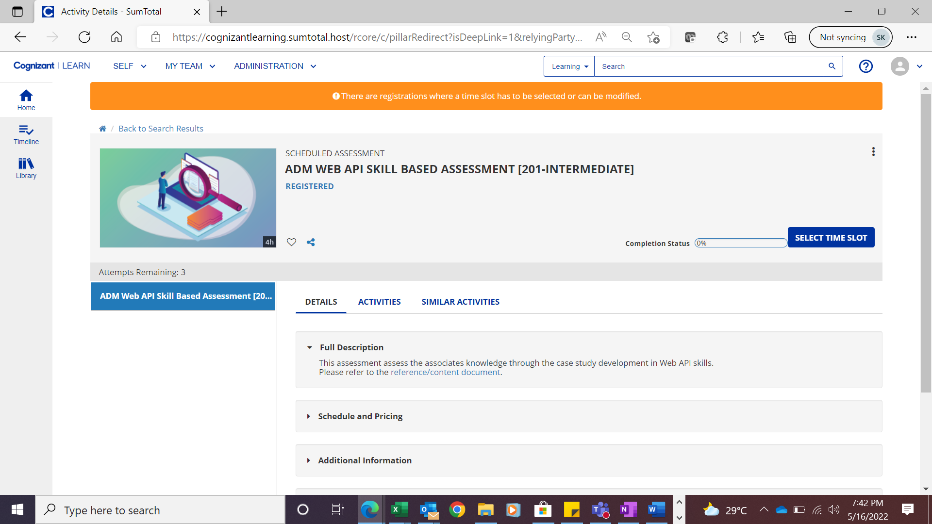
Step 5: Once you registered the screen will appear like this.

Slide 7
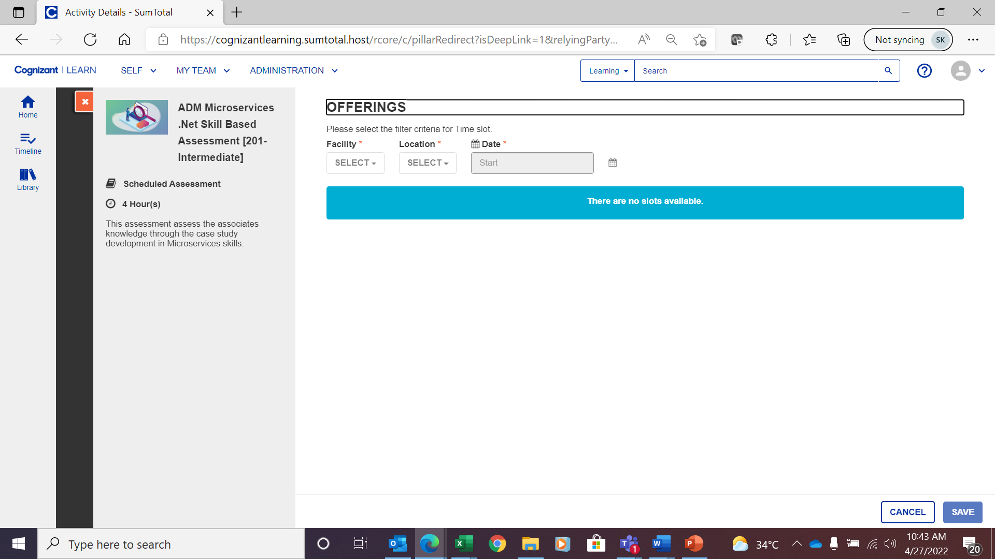
Step 6 : Once you registered select the timeslot screen will appear like this.

Slide 8
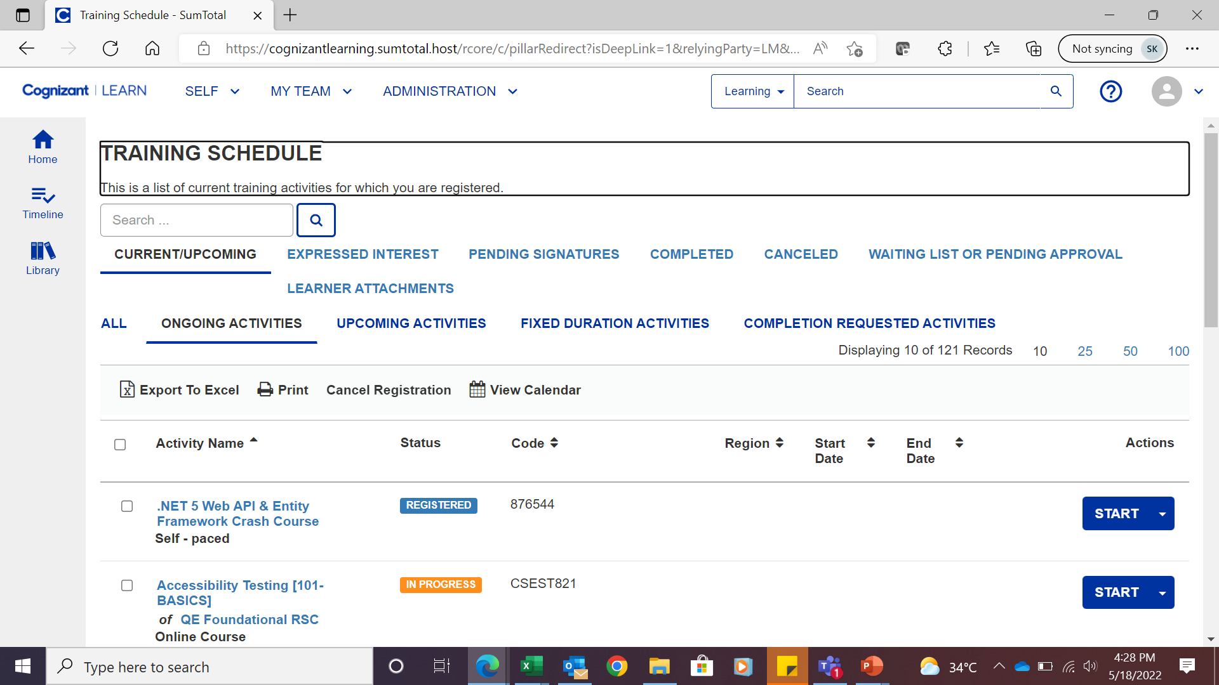
How to take up my assessments?
Please launch the assessment in Clearn
Please refer the below Clearn screenshot for your reference.
Click the to launch through Tekstac url : https://ctsadm.tekstac.com.

Slide 9
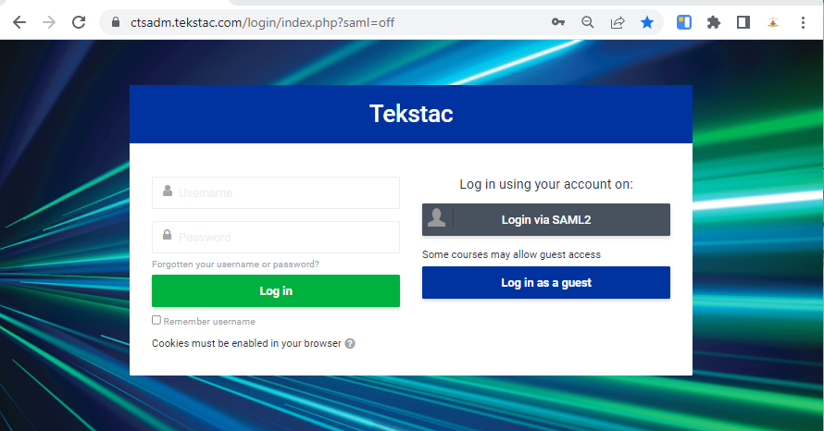
01
Default Login
Use Authorized username and password
02
SSO
Automatically redirected into the home page
Login

Slide 10
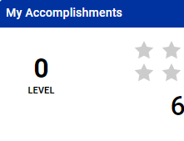
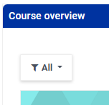
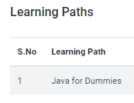
Dashboard Page
01
02
03
My Accomplishments
Learning Path
Course Overview
This part provides an overview of your learning through graphical representation.
This part provides entrollerd learning paths
This part provides entrollerd Course

Slide 11
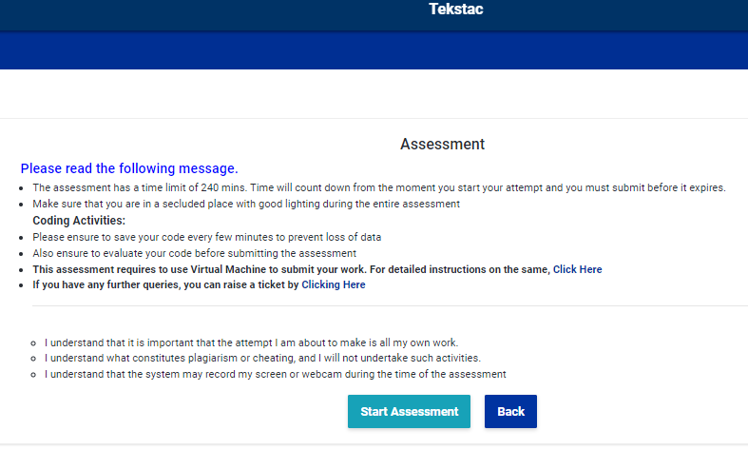
Once select the course as per the
previos slide
Course
1. This is course teaching, and this will appear, indicating that this is an assessment sort of question.
2. Please read all instructions thoroughly. and then press the Start Assessment button.

Slide 12
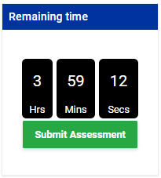
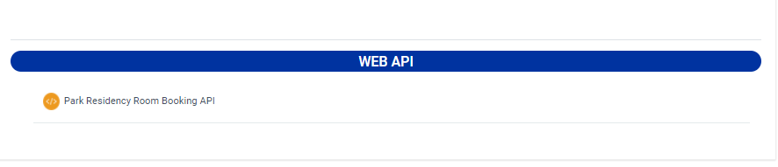
When you click the Start Assessment button, you will be sent to the Question page.
Assessment Question
02
1. Question from this area for which you have chosen a course
2. This section provides the remaining time for this assessment. You must submit the evaluation before the time limit expires, or else the platform will not evaluate your code.
01

Slide 13
Once a question has been chosen, it will be redirected to the implementation page.
Implementation
This page mainly 3 tabs
Description
Submission
Code Editior
This part contains the code editor, which will serve as the IDE.
More information may be found on the next slide.
This section lists all of the assessment's requirements. and mentioned the vital downloading link
This section lists all the submission history for the future reference.

Slide 14
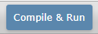
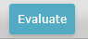
This slide is a continuation of the previous slide's code editor.
Resu
Code Editor
This button is used to verify that the compilation fault has been fixed.
This button might provide us with compilation errors in Visual Studio..
This button is used to receive your implementation's score.
Tekstac has guaranteed that all necessary logic has been applied in compliance with the problem statement.

Slide 15
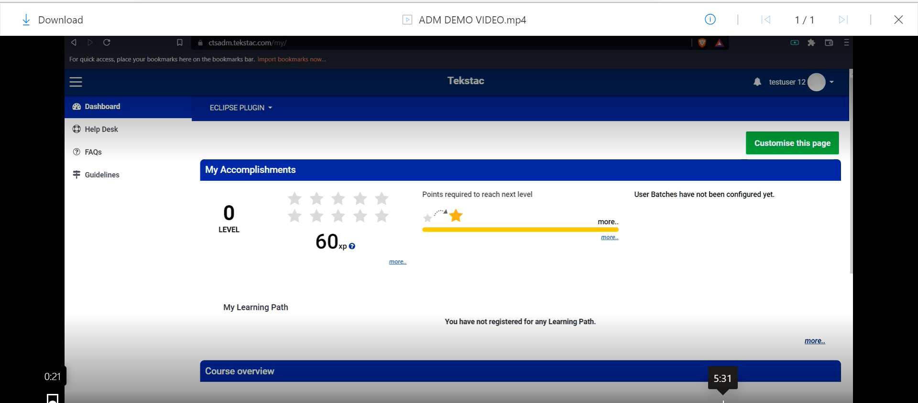
Steps 10 : when you launch the assessment during the registration time slot , assessment home page will appear like this
Insert source or footnote here

Slide 16
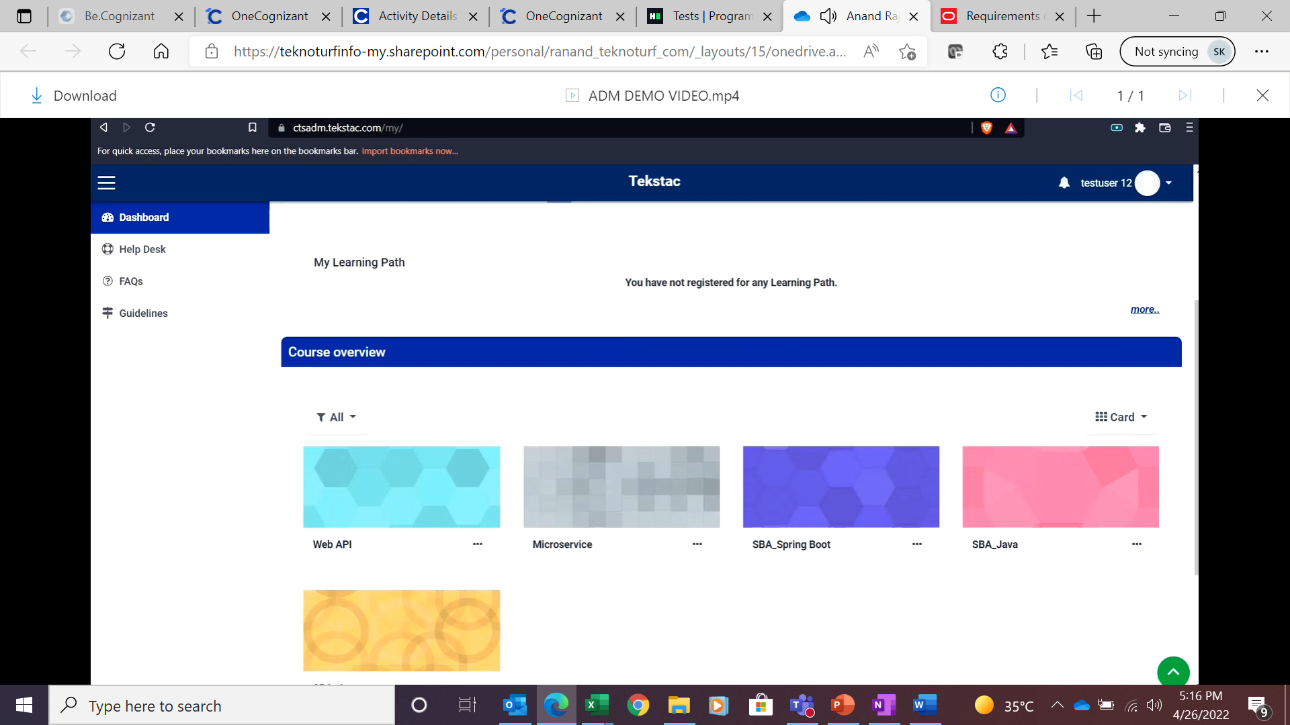
Step 11 : From the list of assessment choose Asp.Net Web API.
Insert source or footnote here

Slide 17
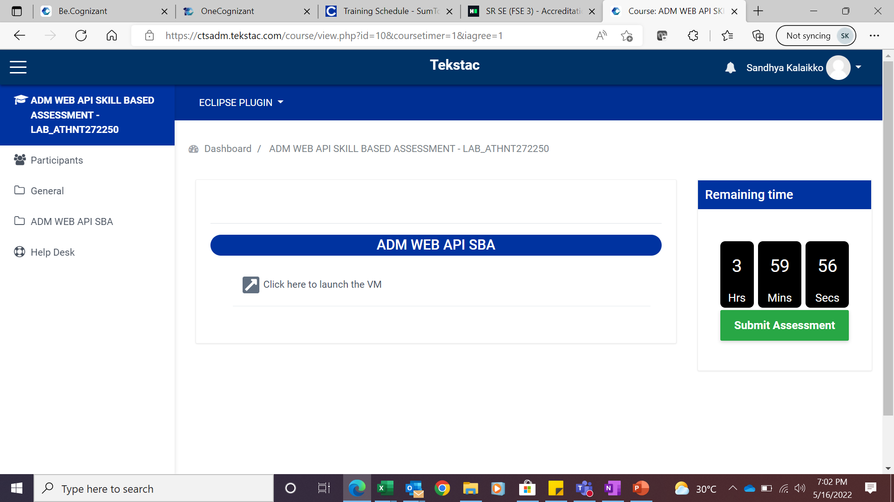
Steps 12 : when you click on start assessment you will get this page and this is timed assessment duration is 4 hours. VM Launch
Insert source or footnote here

Slide 18
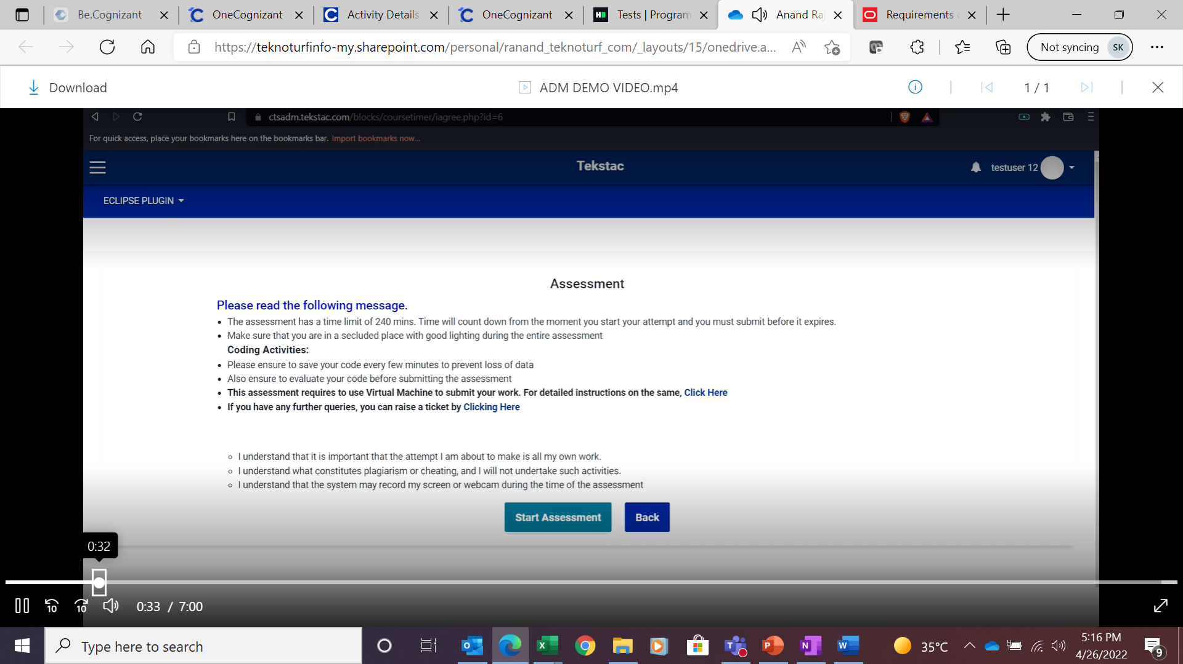
Step 13 : After selecting the skill assessment page appears like this . Please read the guidelines thoroughly before start the assessment
Insert source or footnote here

Slide 19
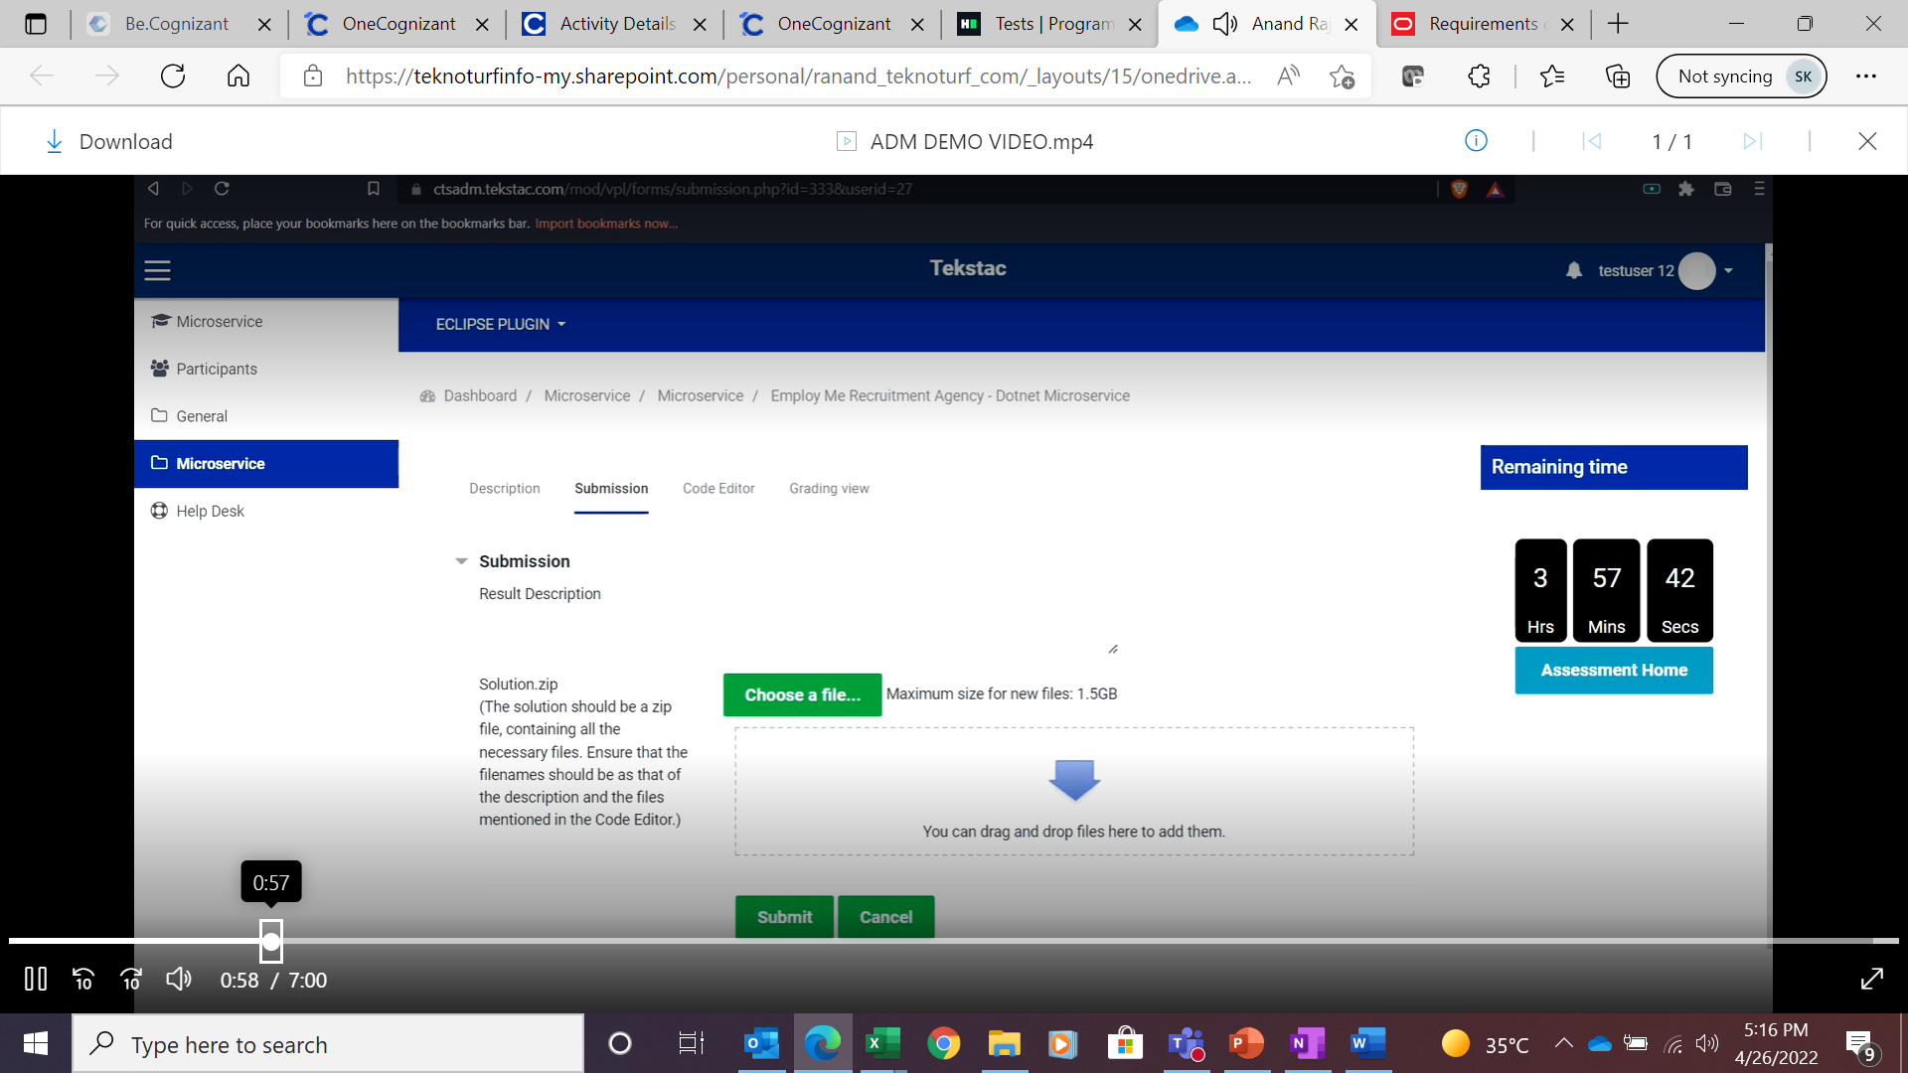
Step 14 : Submission tab this is one of the Important feature in the platform . You are bringing the solution from outside the platform to inside the assessment platform.
Insert source or footnote here

Slide 20
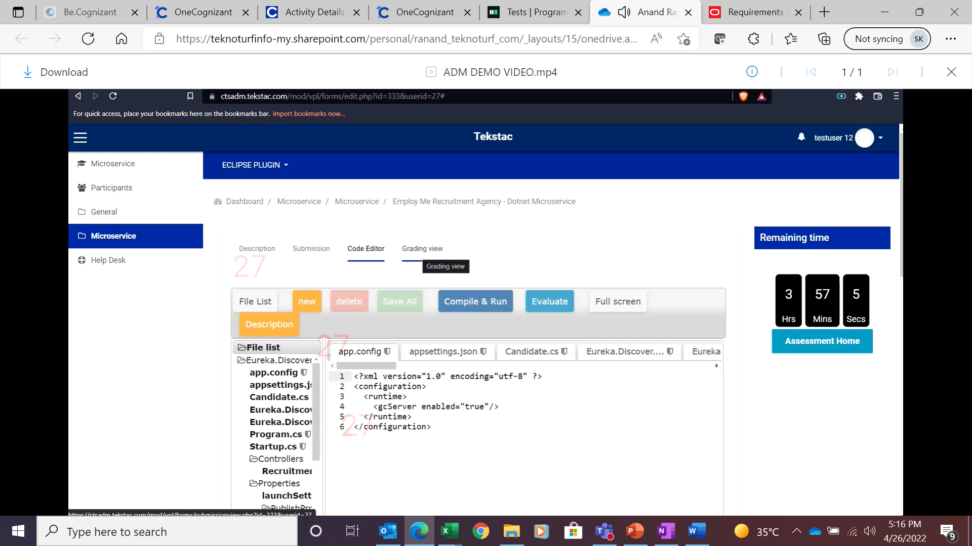
Step 15 : Code editor screen appear like this
Insert source or footnote here

Slide 21
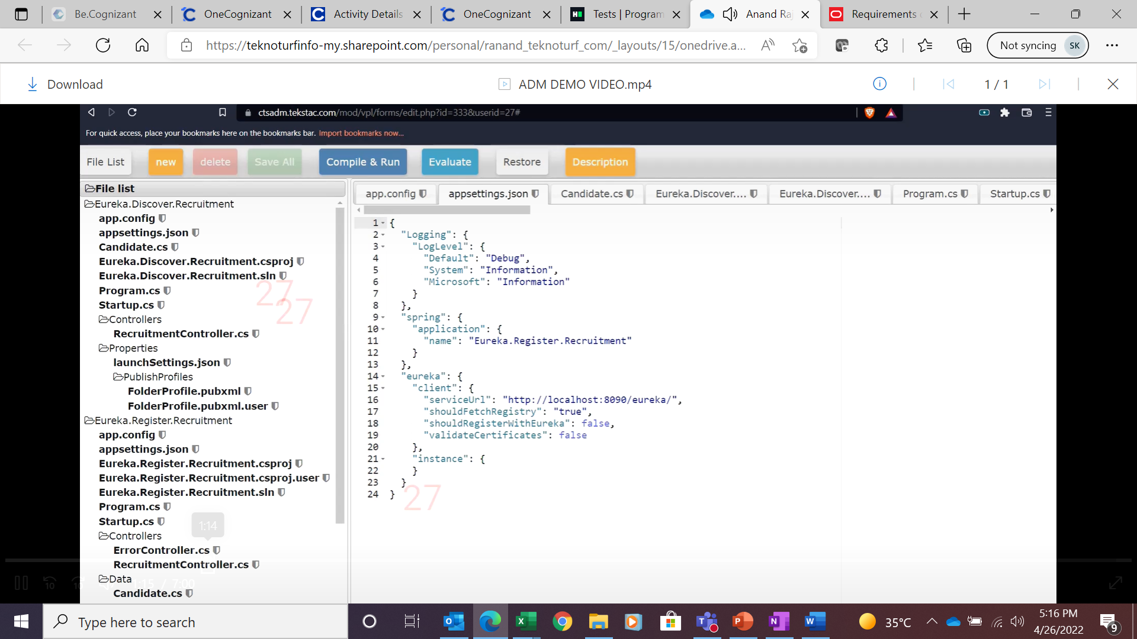
Step 16 : Template is already available .
Insert source or footnote here

Slide 22
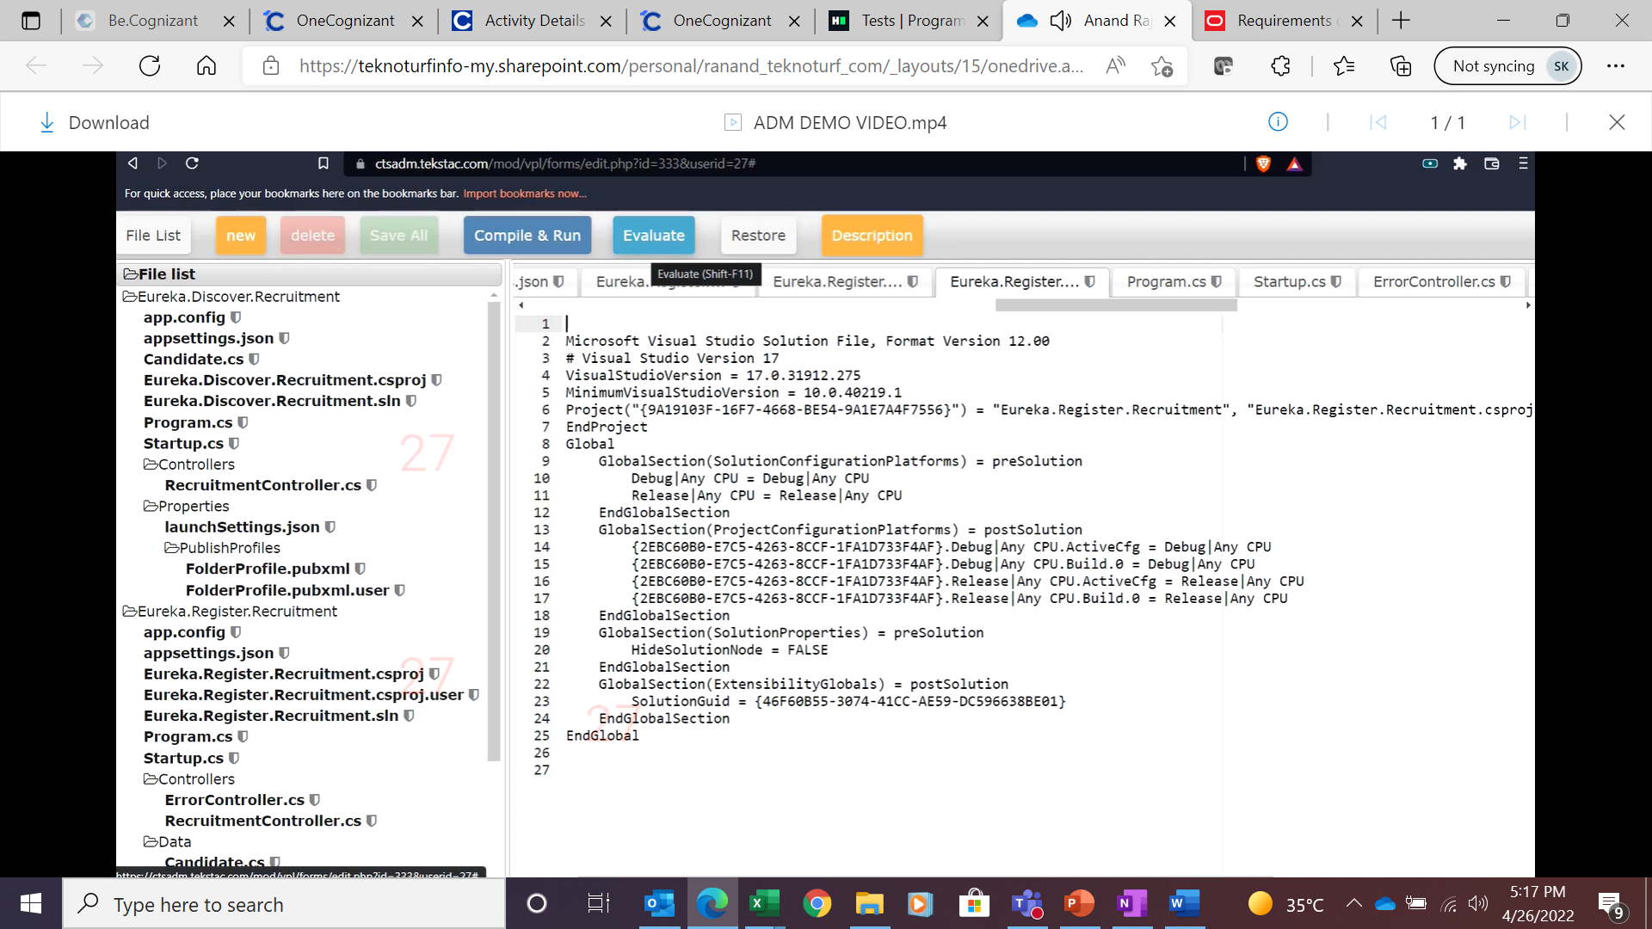
Step 17 : File list on the left side.
Insert source or footnote here

Slide 23
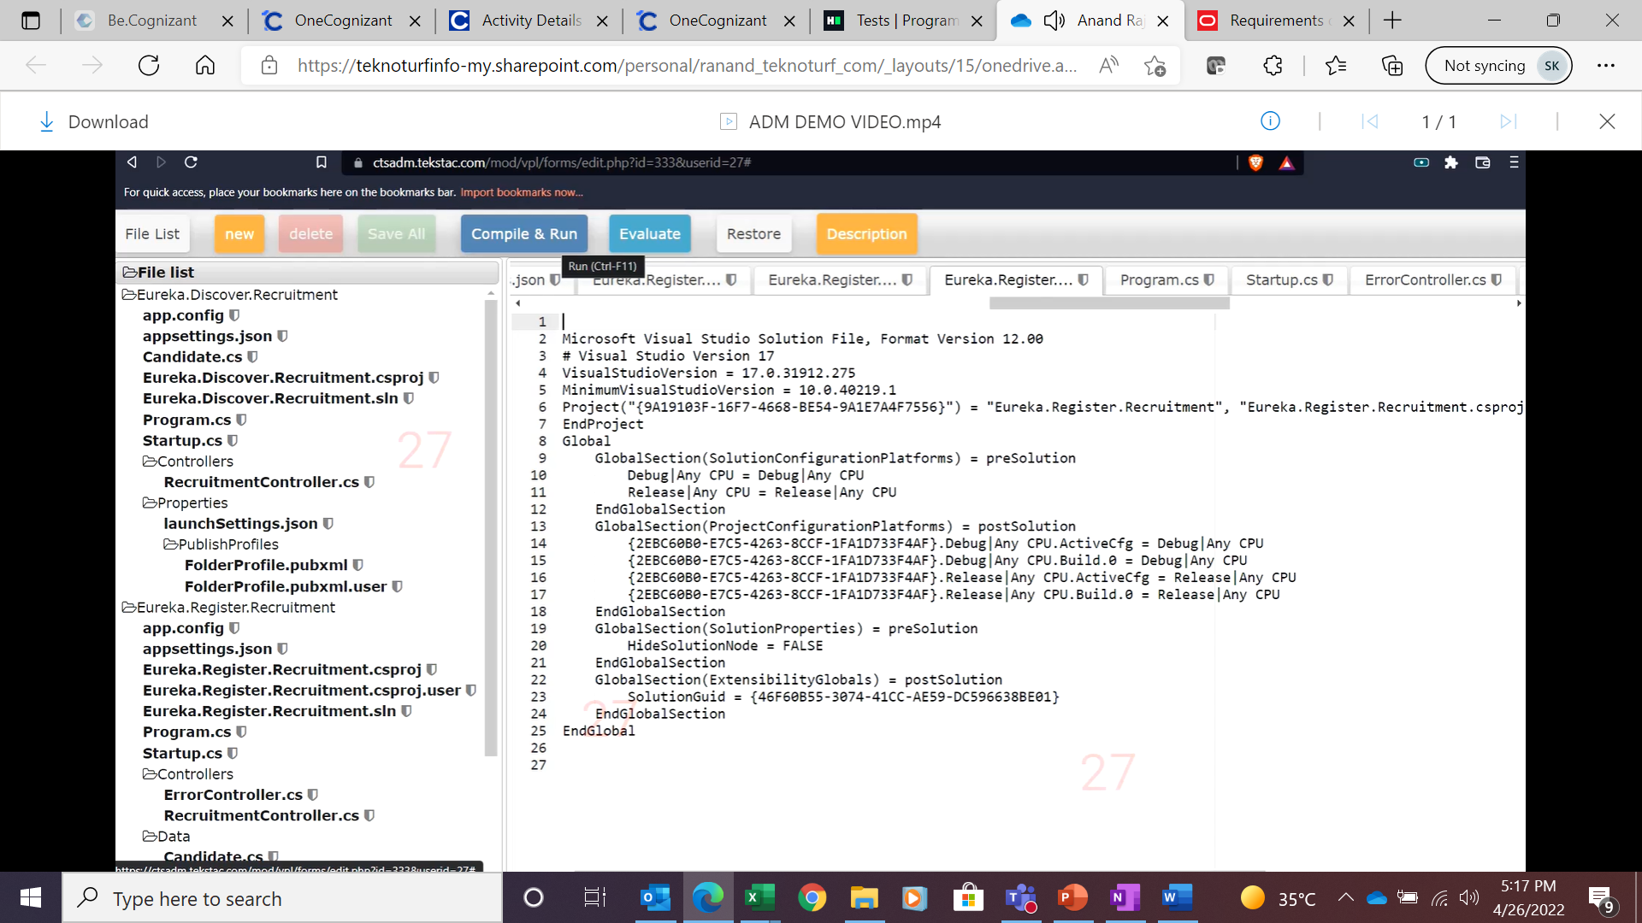
Step 18 : After placing the solution with appropriate files you must click on Save , Compile &Run and Evaluate and your solutions will be evaluated against all the test cases . If you shown any test case failed in evaluation then you must re-work on your solution and evaluate once again Compile & Run – will show you the mistakes if there any Evaluate – Will help you the code written in the background., Ensure your code is on error free before clicking on Evaluate.
Insert source or footnote here

Slide 24
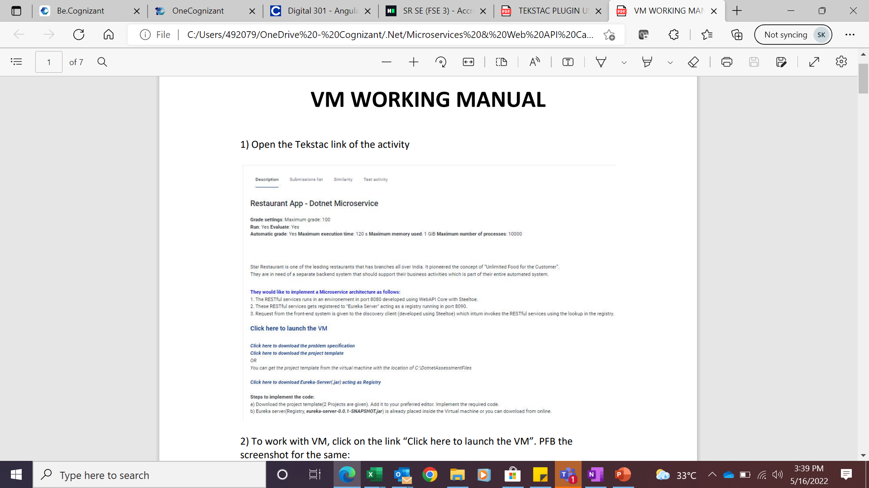
Step 19 : Open the Tekstac link, To work with VM, click on the link “Click here to launch the VM”. PFB the screenshot for the same: Wait for few sec
Insert source or footnote here

Slide 25
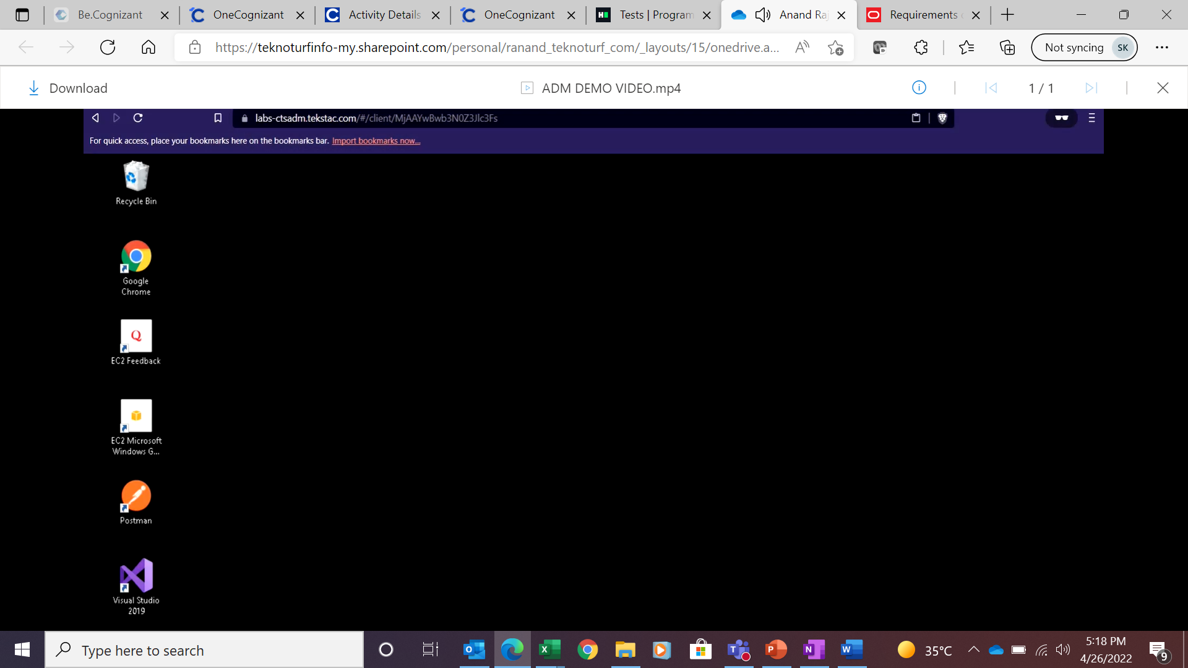
Step 20 : VM launch screen
Insert source or footnote here

Slide 26
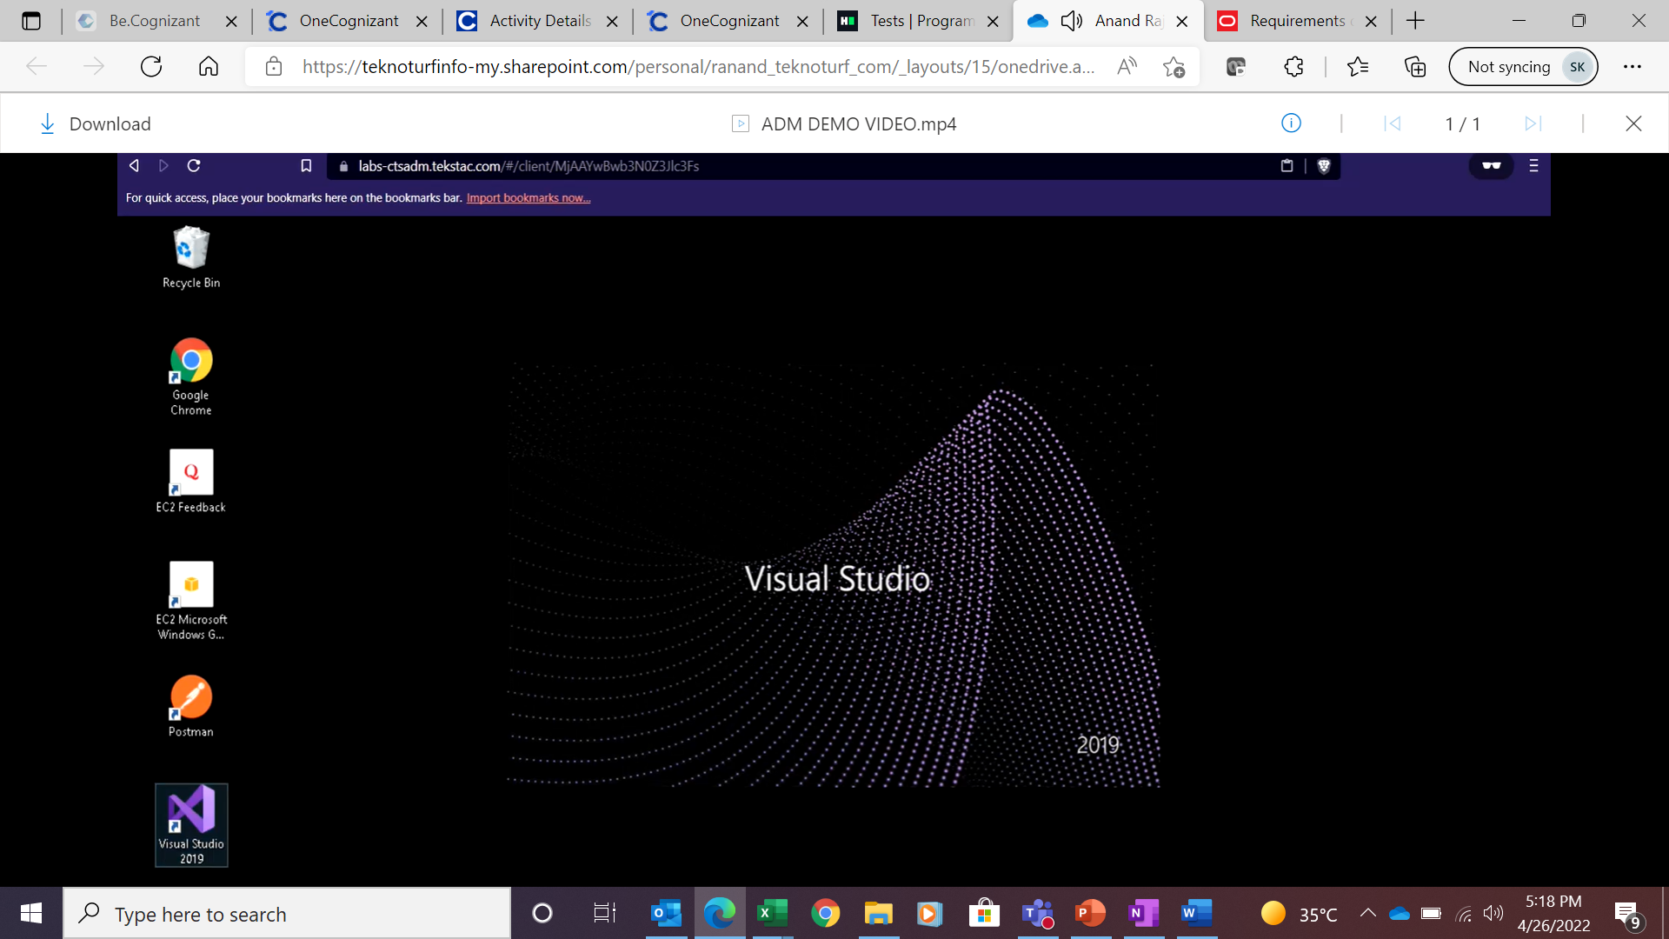
Step 21 : VM click Visual studio
Insert source or footnote here

Slide 27
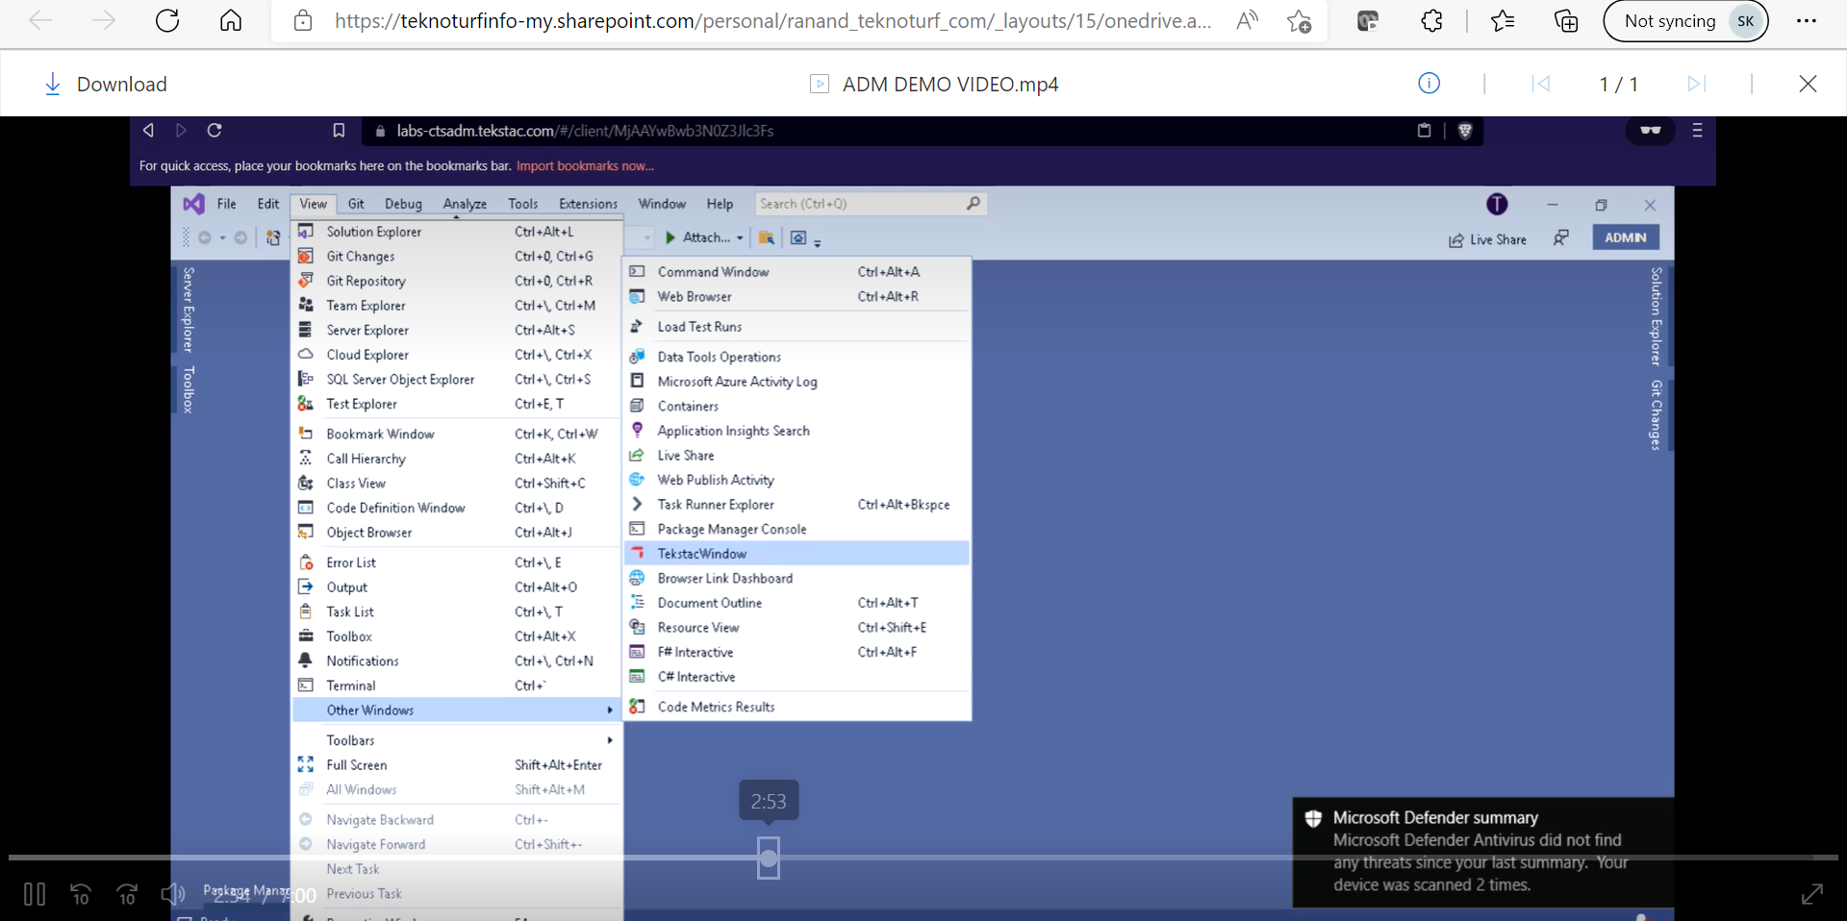
Step 22 : VM -> Visual studio we are using tekstac platform
Insert source or footnote here

Slide 28
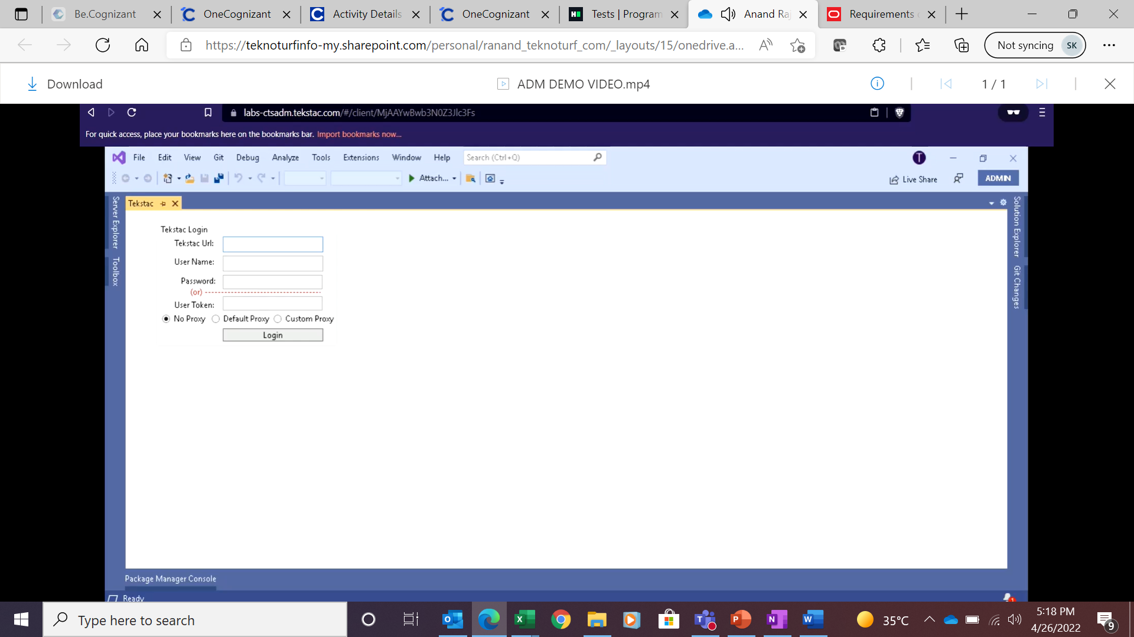
Step 23 : Tekstac login screen For Example : Tekstacurl : https://ctsadm.tekstac.com/ User name and Password - (Use your credentials) Select NoProxy radio button
Insert source or footnote here

Slide 29
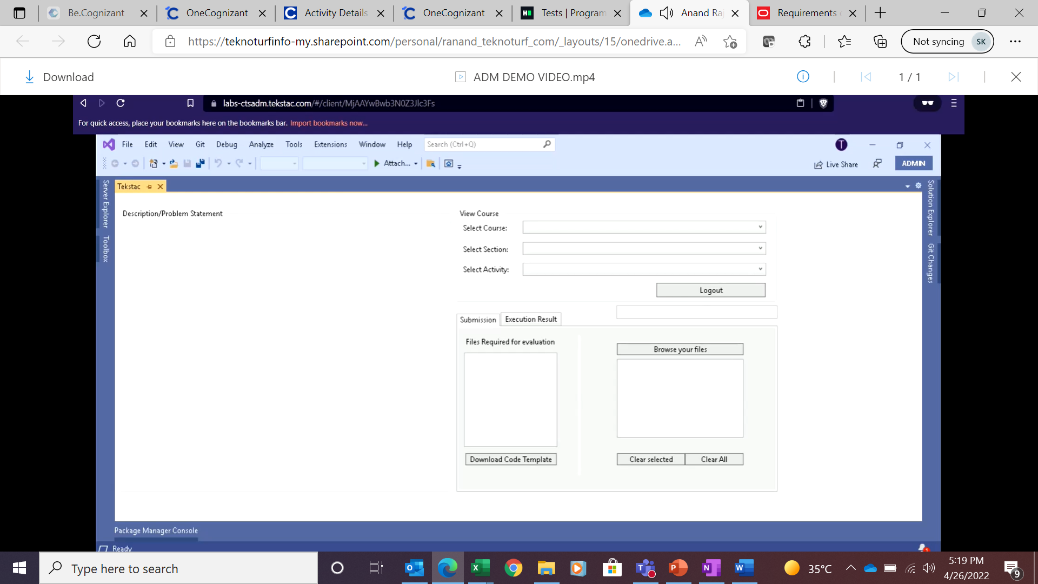
Step 24 : Tekstac home screen
Insert source or footnote here

Slide 30
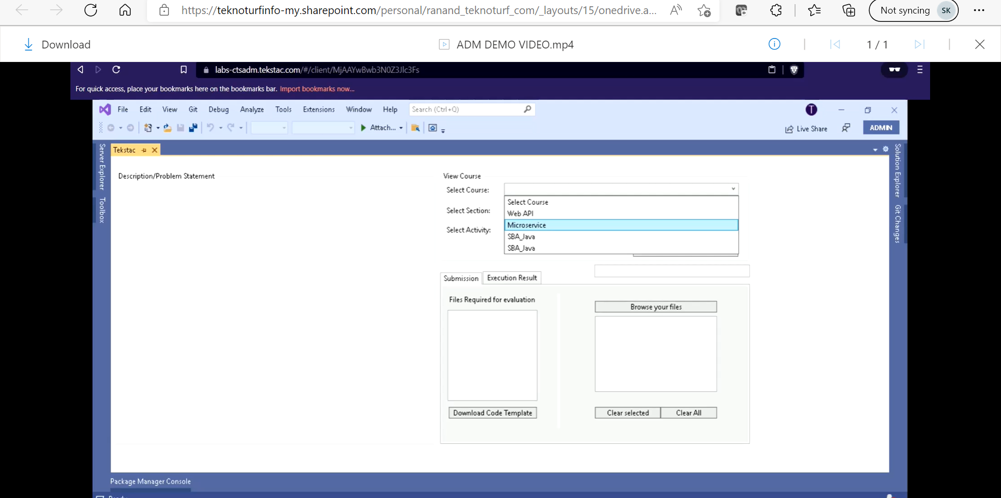
Step 25 : Tekstac home screen we are selecting skill
Insert source or footnote here

Slide 31
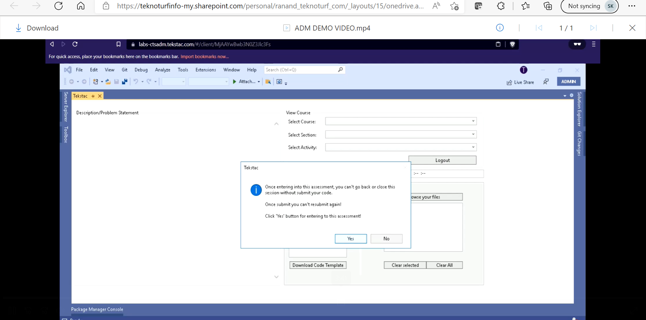
Step 26: Tekstac once you selected all the activity click yes in the dialog bpx.
Insert source or footnote here

Slide 32
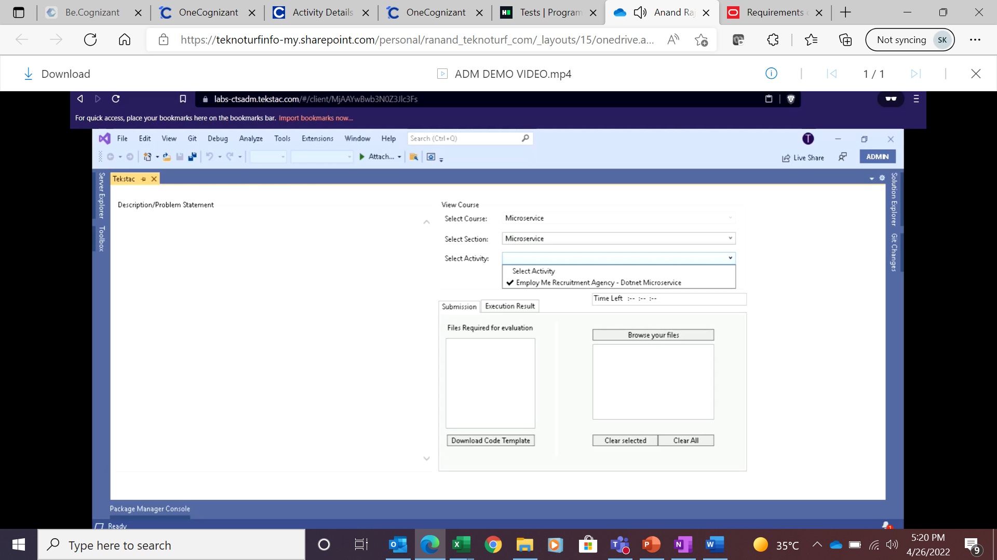
Step 27 : Tekstac select activity
Insert source or footnote here

Slide 33
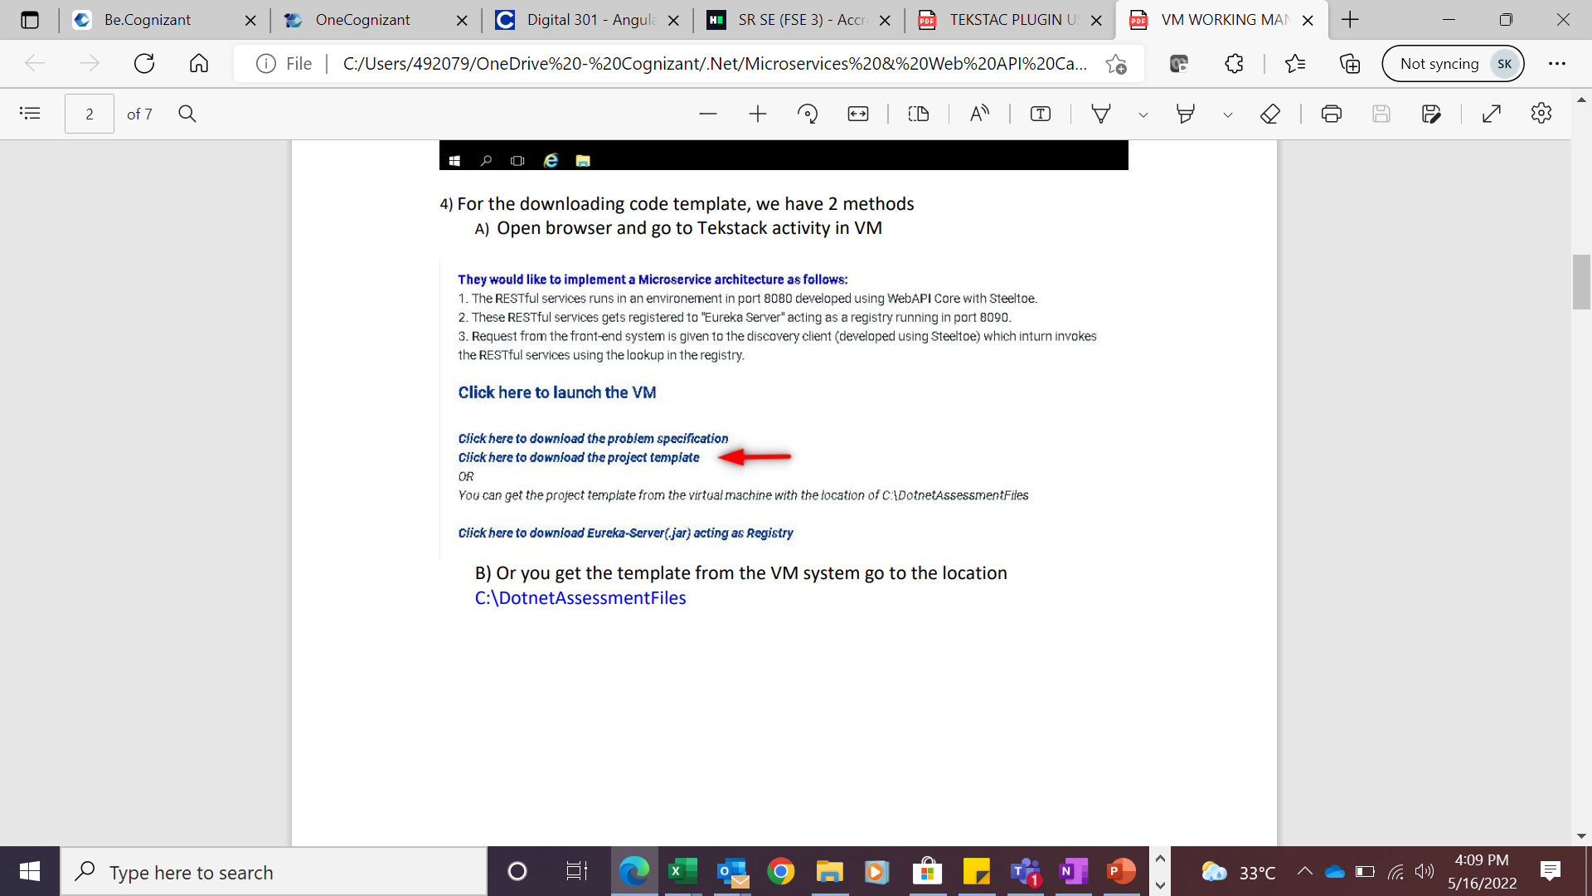
Step 28 : For the downloading code template, we have 2 methods which we have highlighted below
Insert source or footnote here

Slide 34
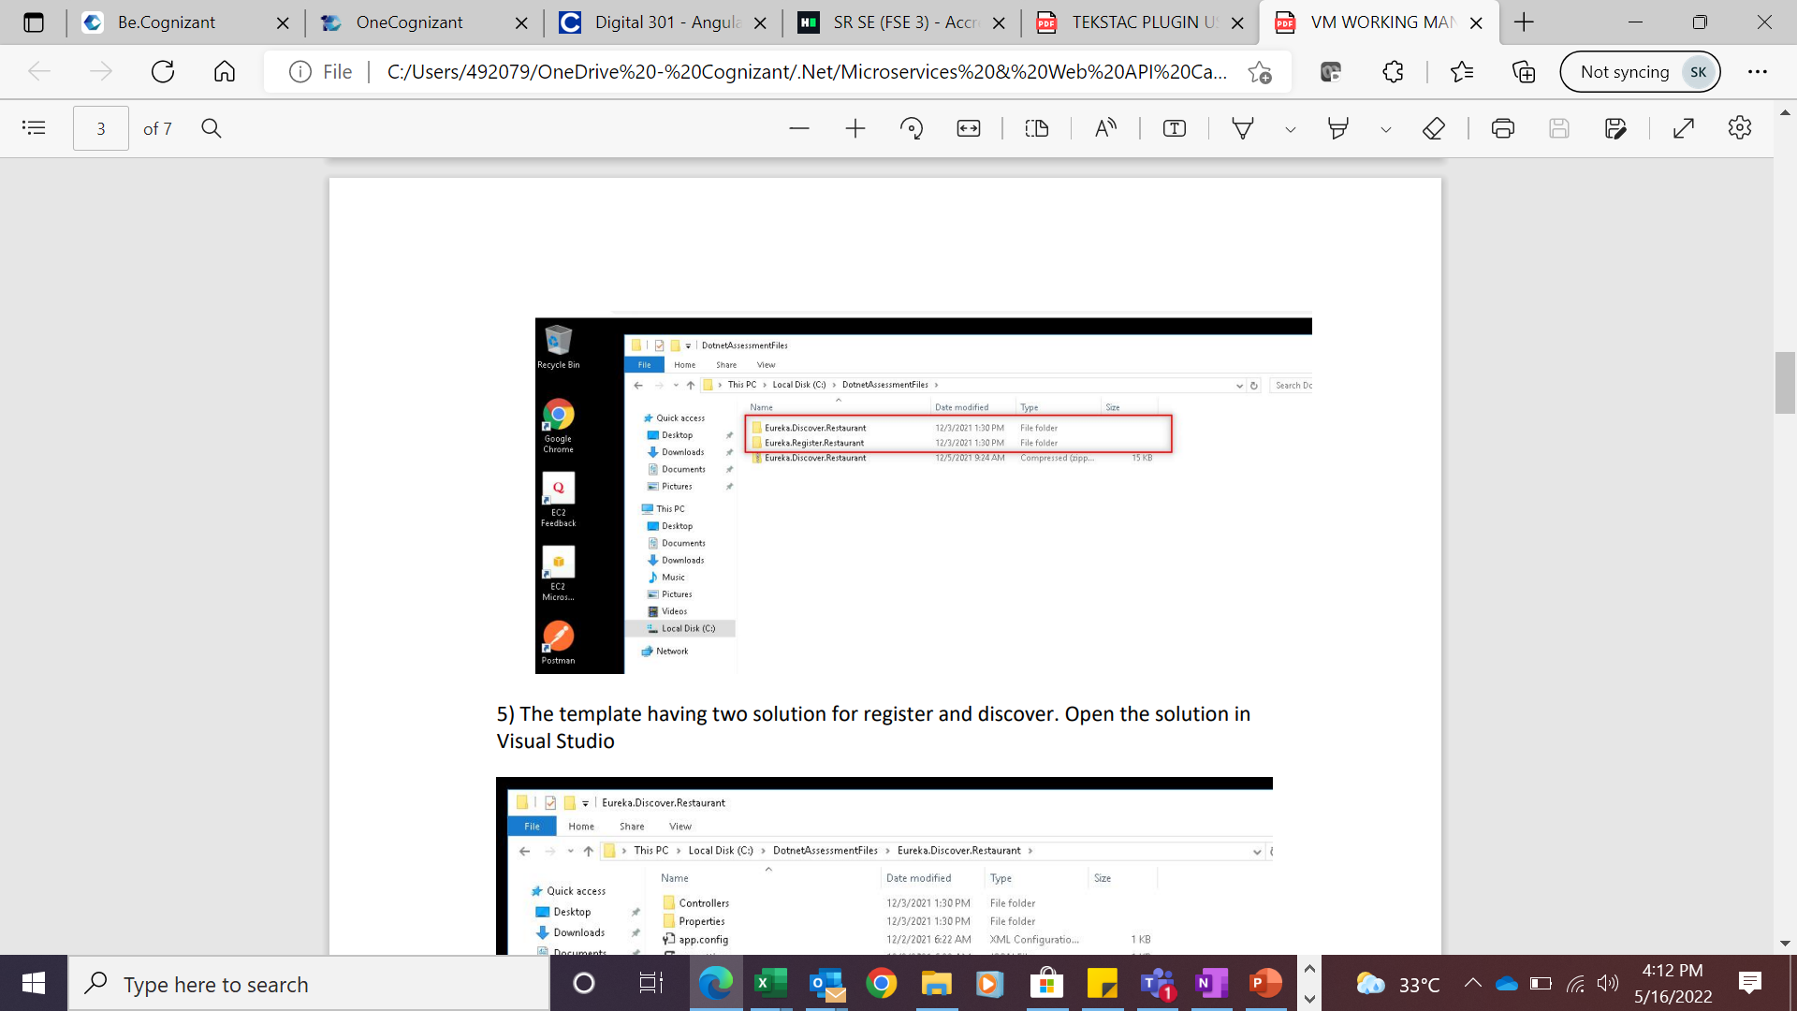
Step 29 : The template having two solution for Register and Discover.
Insert source or footnote here

Slide 35
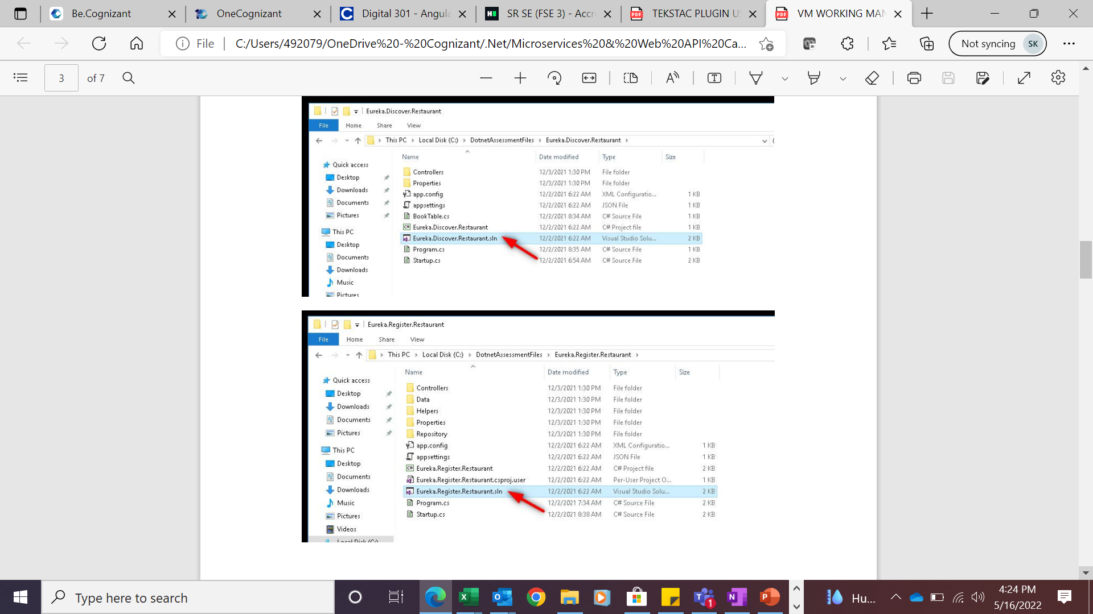
Step 30 : The template having two solution for Register and Discover. Open the solution in Visual Studio.
Insert source or footnote here

Slide 36
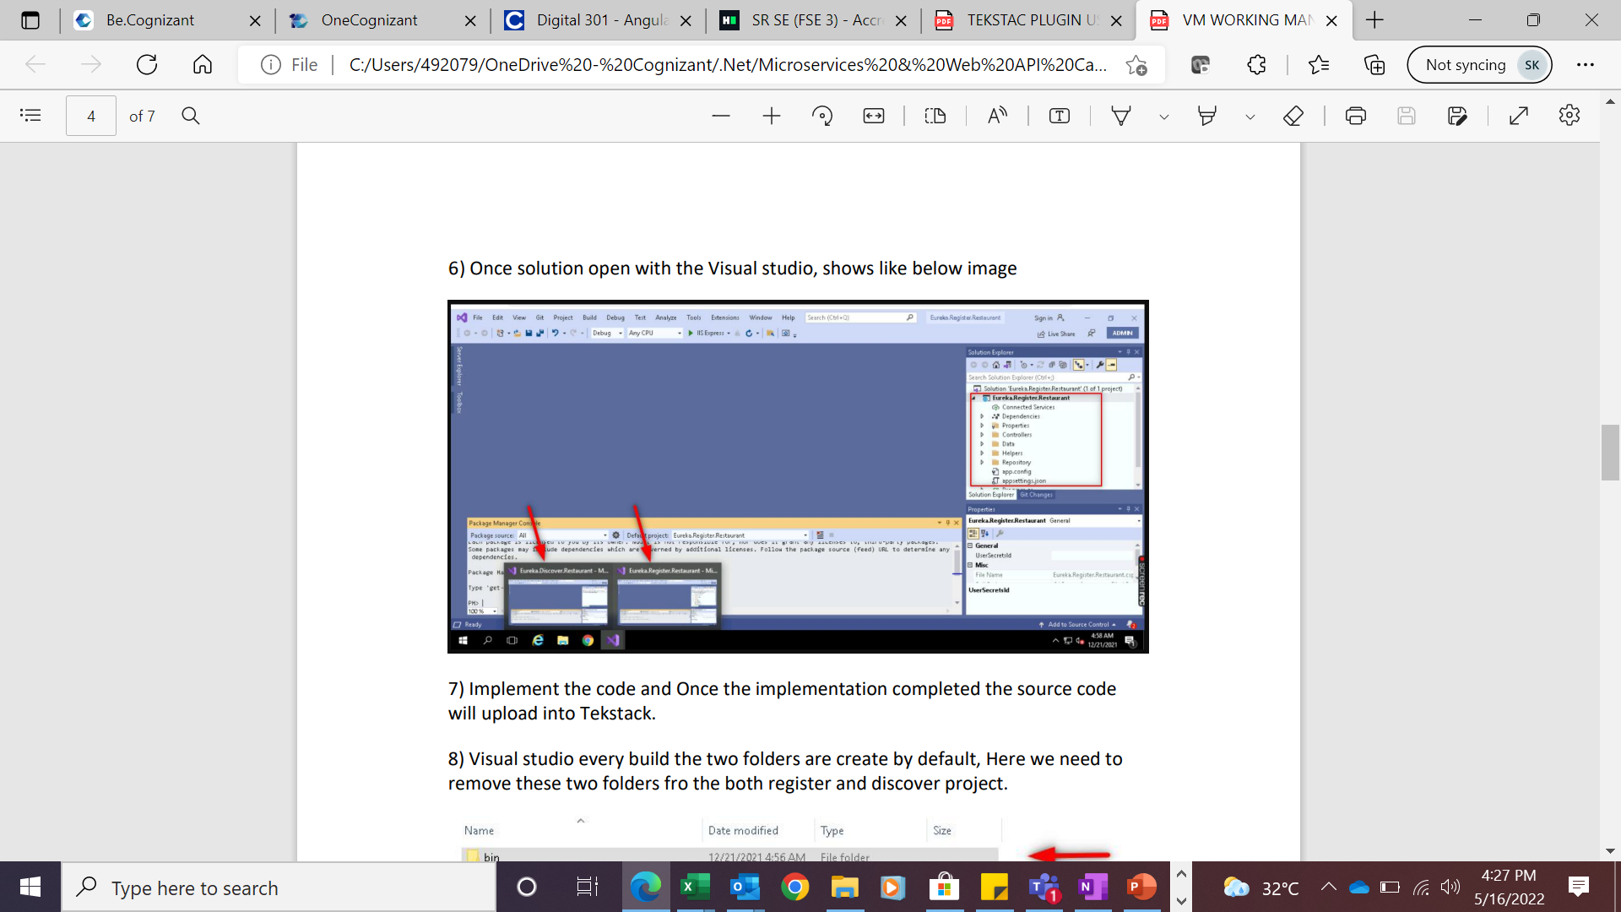
Step 31 : Once solution open with the Visual studio, shows like below image.
Insert source or footnote here

Slide 37
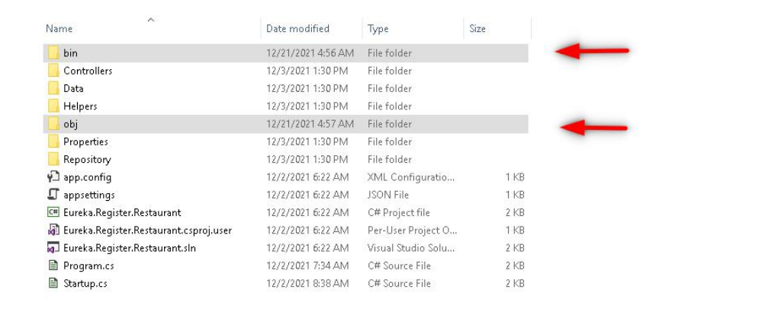
Step 32 : Implement the code and Once the implementation completed the source code will upload into Tekstack Visual studio every build the two folders are create by default, Here we need to remove these two folders for the both register and discover project.
Insert source or footnote here

Slide 38
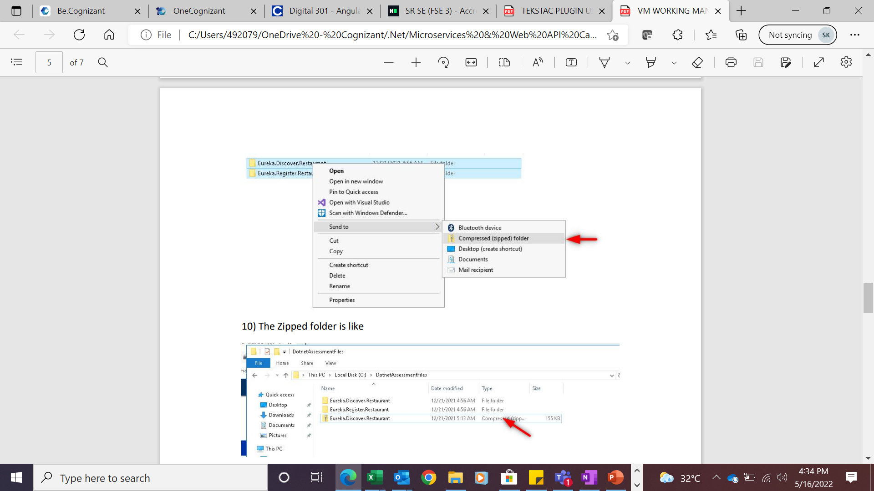
Step 33 : Zip the folder once removed the folders, as per the below image.
Insert source or footnote here

Slide 39
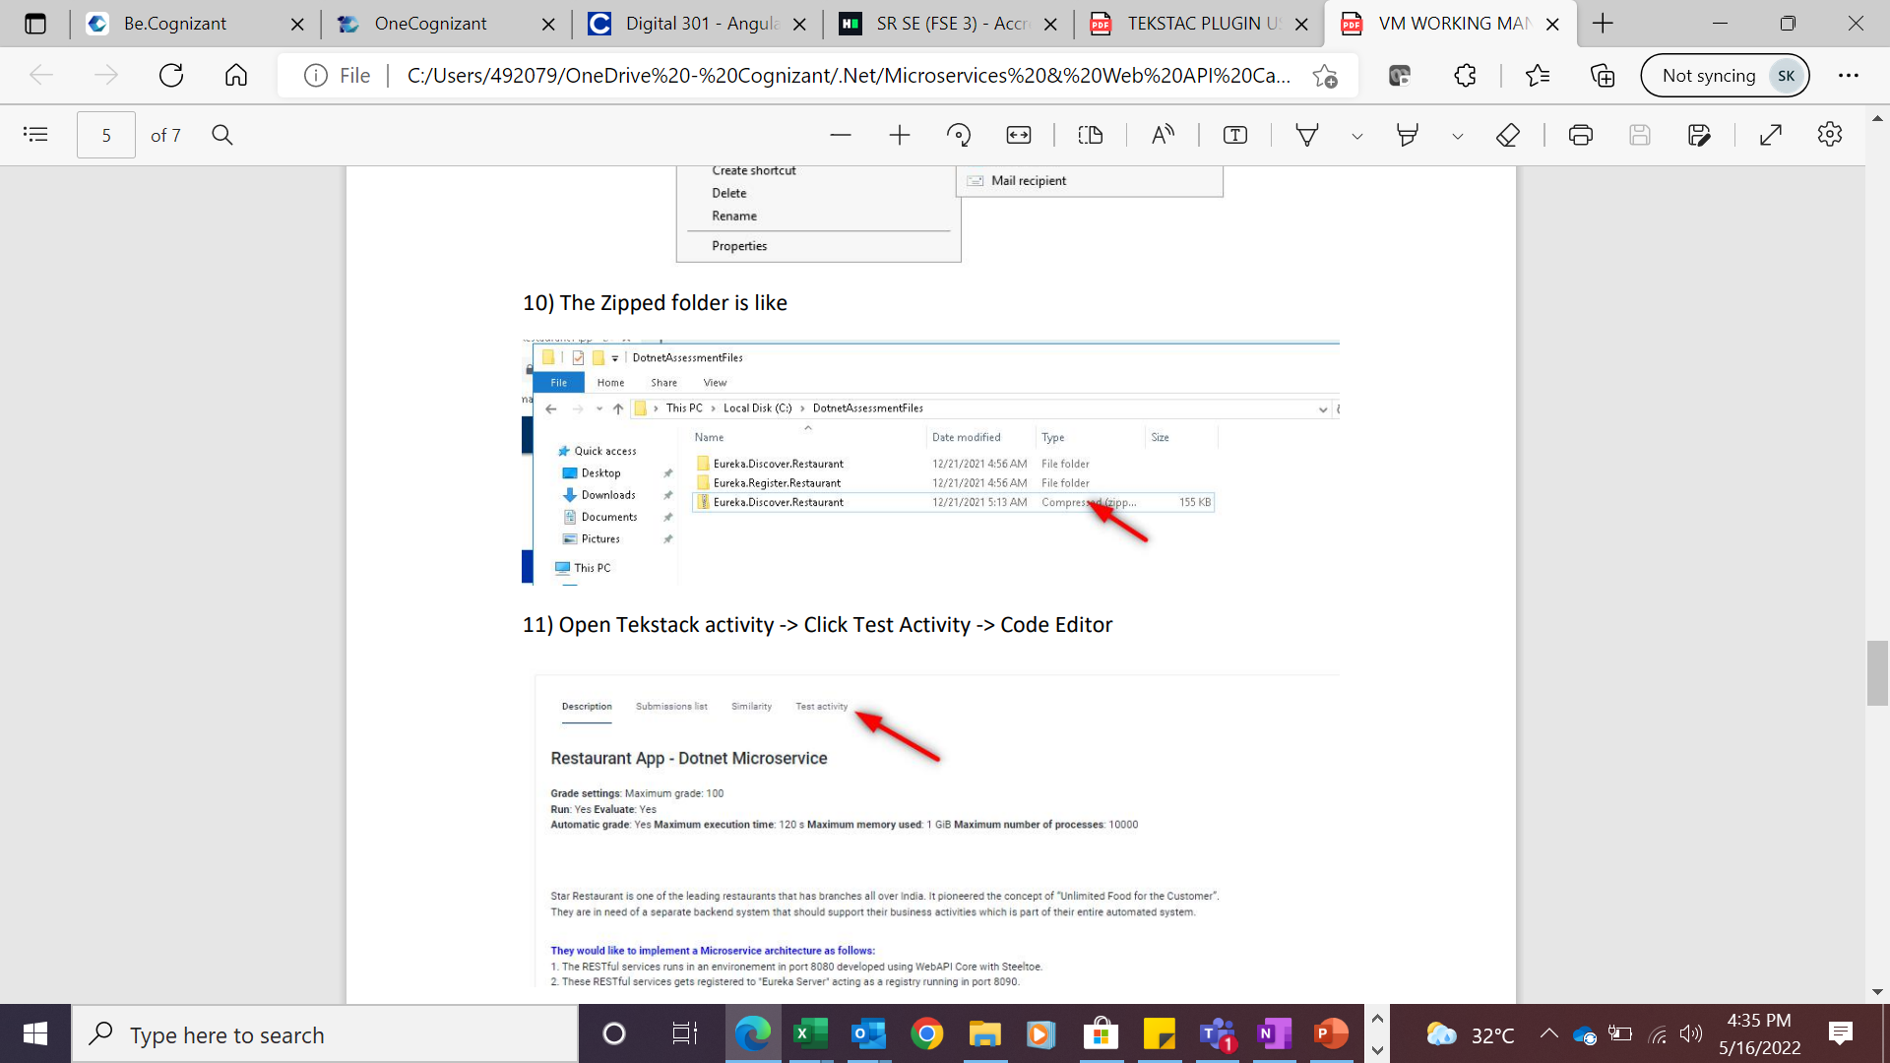
Step 34 :The Zipped folder will look like this.
Insert source or footnote here

Slide 40
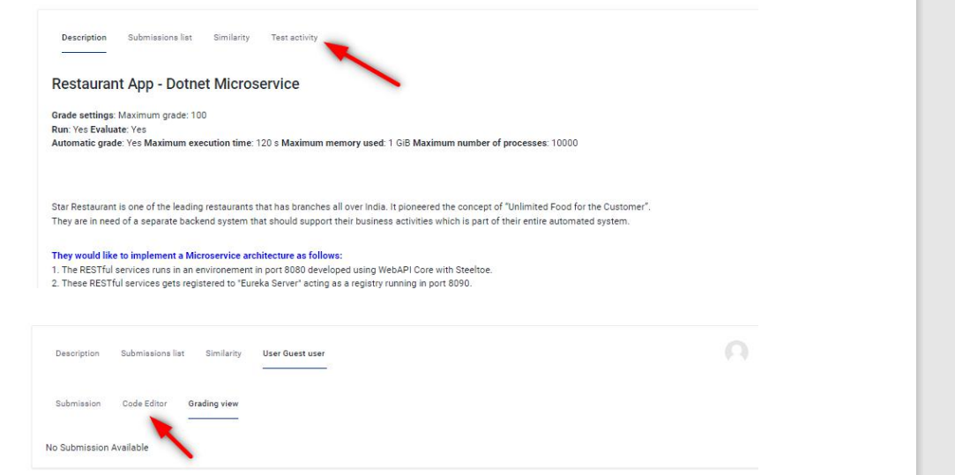
Step 35 :Open Tekstack activity -> Click Test Activity -> Code Editor.
Insert source or footnote here

Slide 41
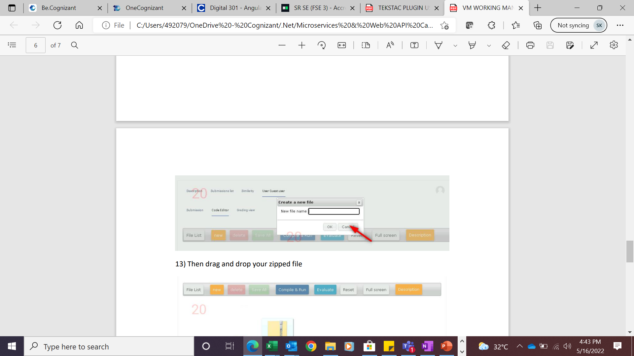
Step 36 :Click the cancel button.
Insert source or footnote here

Slide 42
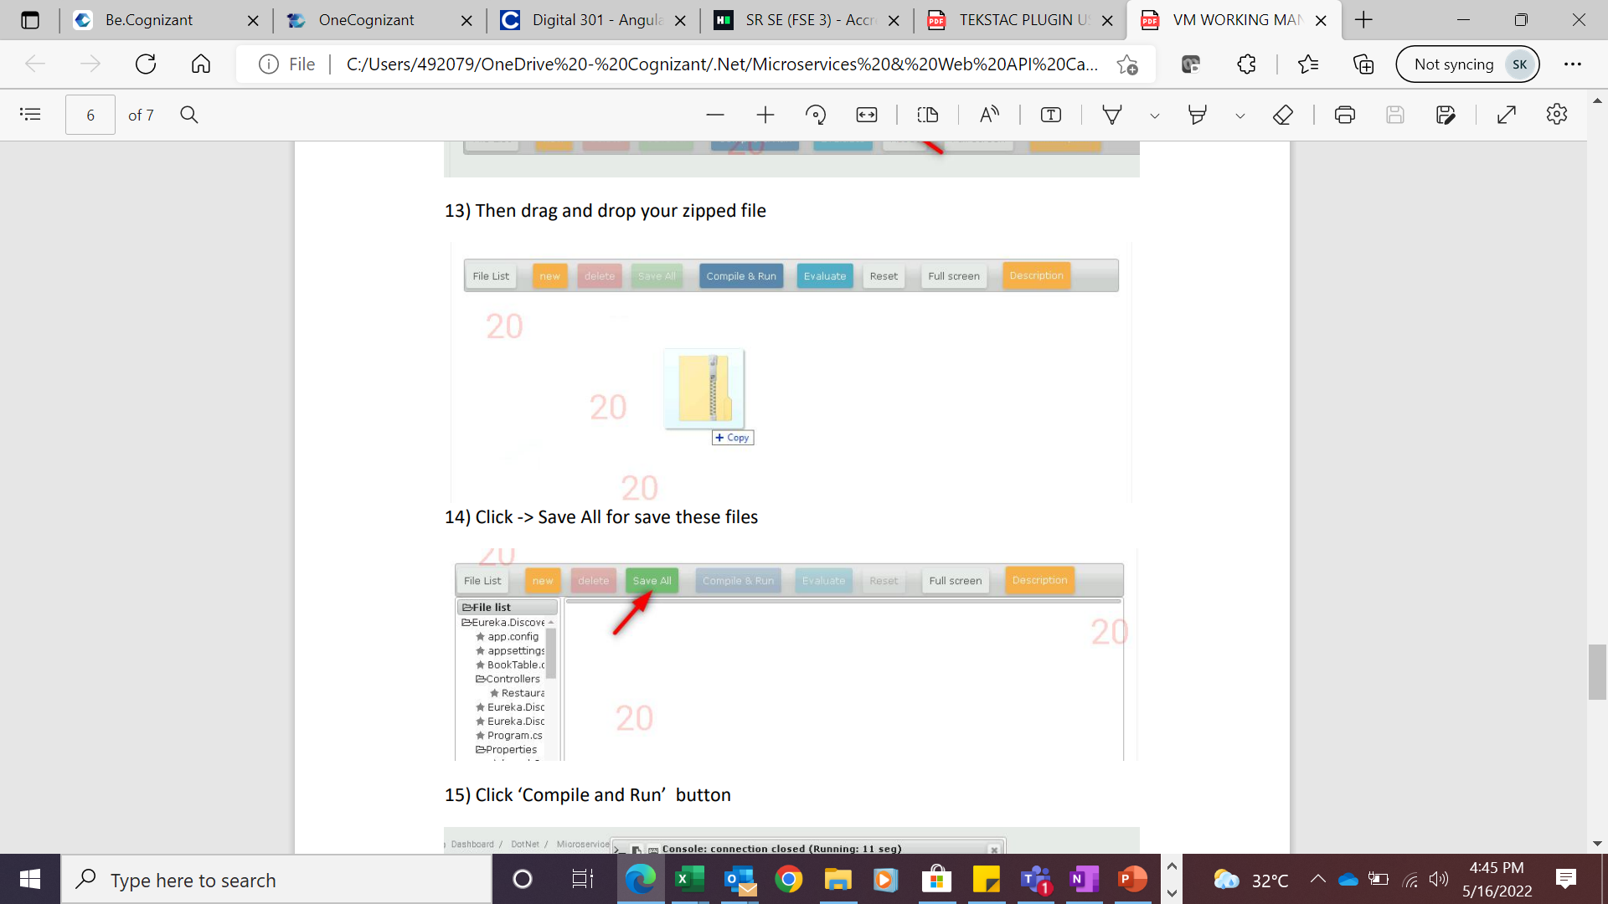
Step 37 :Then drag and drop your zipped file.
Insert source or footnote here

Slide 43
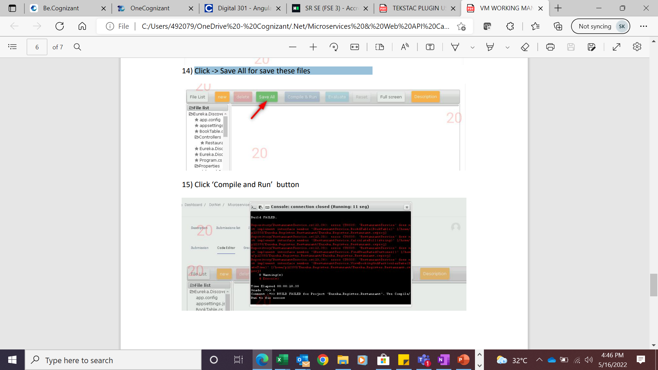
Step 38 :Click -> Save All for save these files.
Insert source or footnote here

Slide 44
Step 39 :Click ‘Compile and Run’ button. The console pop up will shows the status, if have errors implement the code as per the problem statement. You can edit the same teksatck window or repeat the step from
Insert source or footnote here

Slide 45
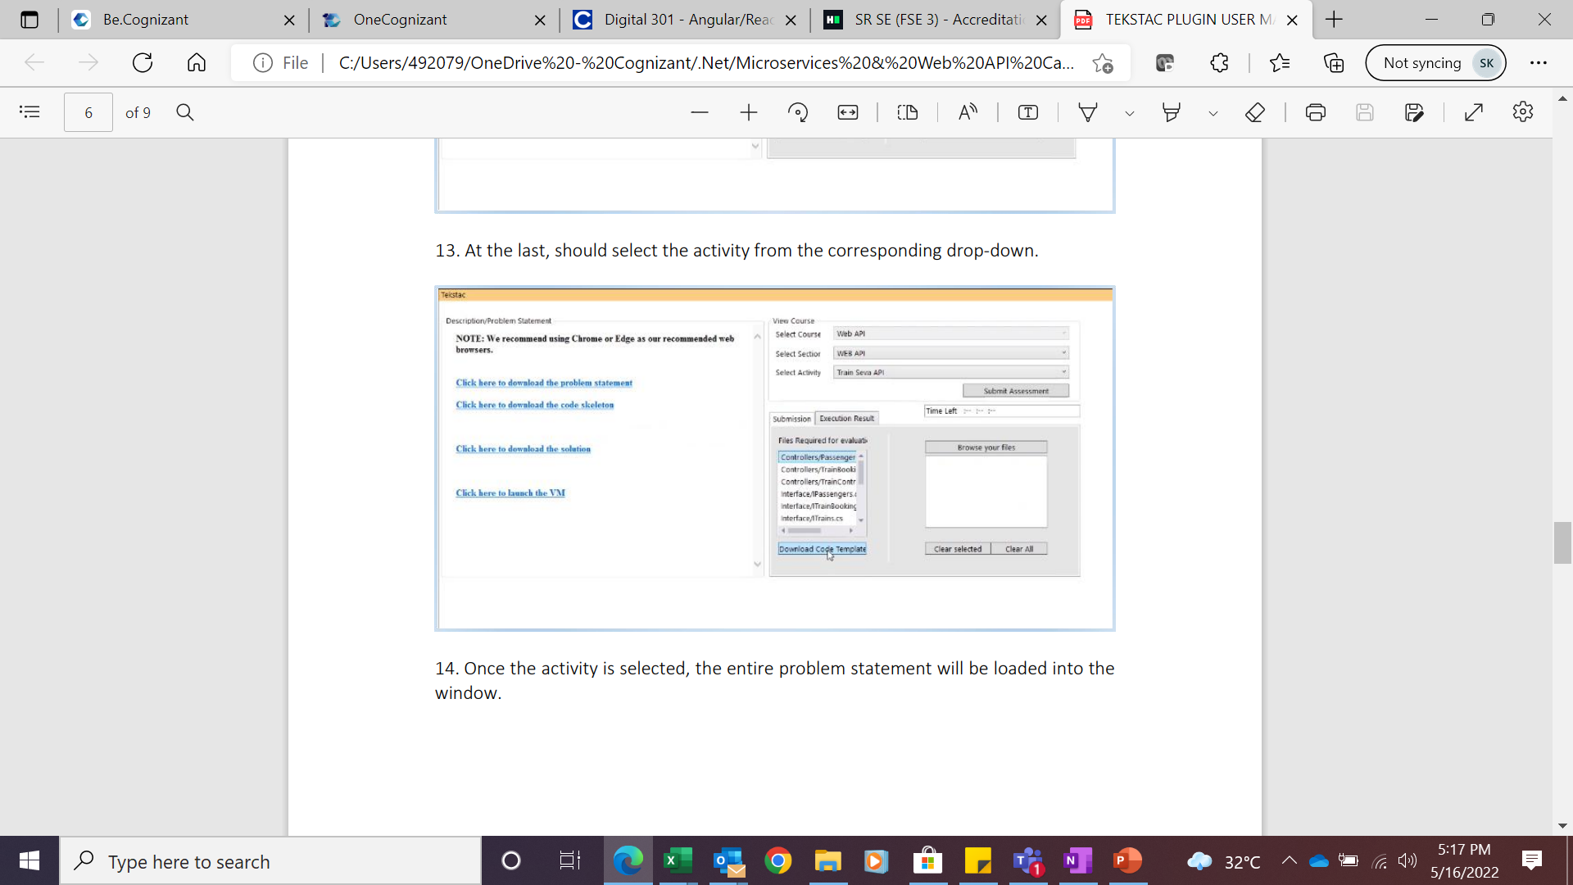
Step 40 : At the last, should select the activity from the corresponding drop-down.
Insert source or footnote here

Slide 46
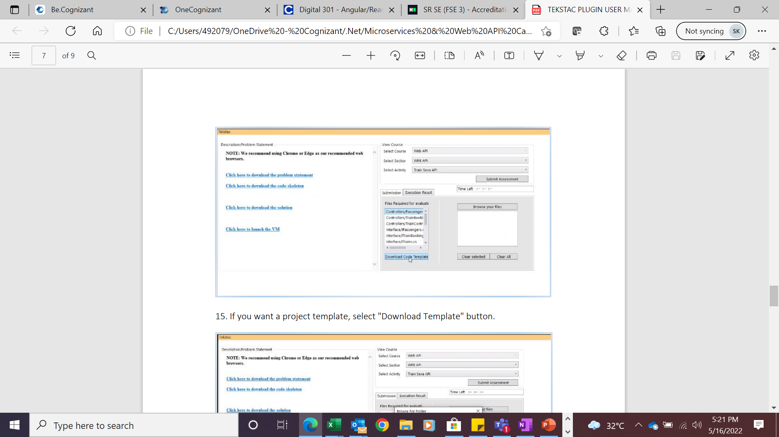
Step 41 : Once the activity is selected, the entire problem statement will be loaded into the window.
Insert source or footnote here

Slide 47
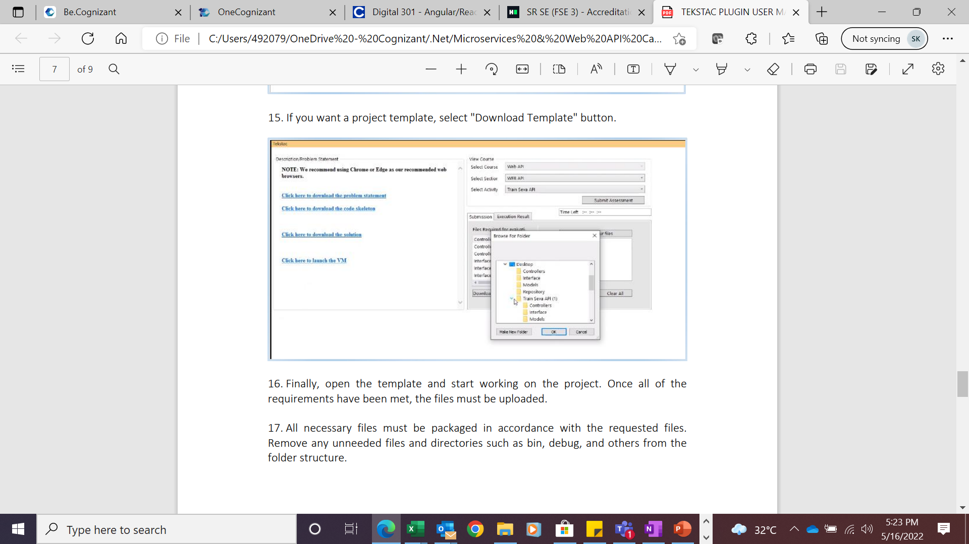
tep 42 : If you want a project template, select "Download Template" button.
Insert source or footnote here

Slide 48
Step 43 :Finally, open the template and start working on the project. Once all of the requirements have been met, the files must be uploaded.
Insert source or footnote here

Slide 49
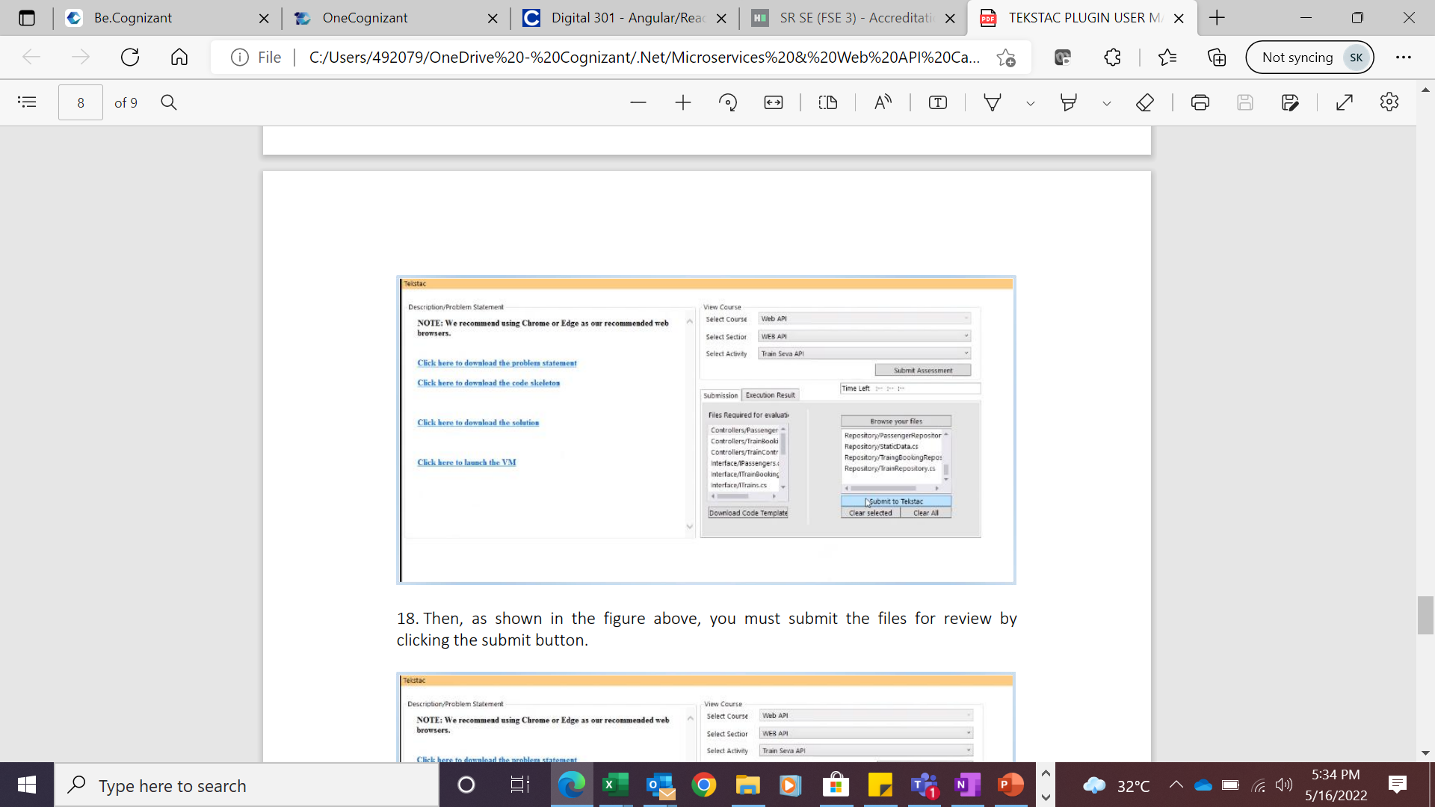
Step 44 : All necessary files must be packaged in accordance with the requested files. Remove any unneeded files and directories such as bin, debug, and others from the folder structure.
Insert source or footnote here

Slide 50
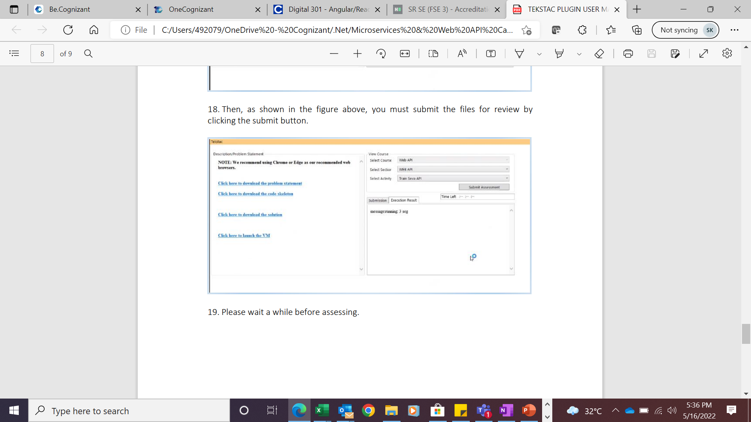
Step 45 : Then, as shown in the figure above, you must submit the files for review by clicking the submit button.
Insert source or footnote here

Slide 51

Step 46 : Please wait a while before assessing .
Insert source or footnote here

Slide 52

Step 47 :Error free means you can click the evaluate button to find the grade.
Insert source or footnote here

Slide 53
Step 47 :Error free means you can click the evaluate button to find the grade.
Insert source or footnote here

Slide 54

When you click the evaluate button, the outcome looks like this.
Result
01
Proposed Grade
02
Result Description
03
Name of the test case and its weightage

Slide 55
Thank you
ADM Solutions

